Slide 1
UW Datahub
Broker’s Guide to Quoting with the UWDataHub
October 2024
An independent licensee of the Blue Cross and Blue Shield Association

Slide 2
Account Sign-Up Dashboard Monitoring Groups
1
2
Training Outline
3
Census Application (10+ enrolled)
Group Setup & Personal Health Apps (5-9 enrolled)
Reports

Slide 3
Establishing Access

Slide 4
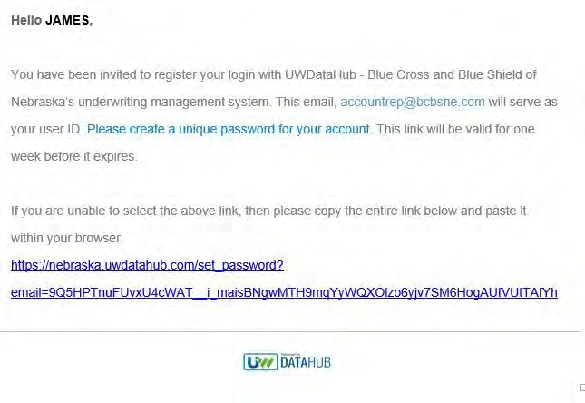
Email Notification/Account Setup
Email Broker_Appointment@Nebraskablue.com requesting access to the UWDataHub
An email notification will be sent
Click the link and follow the instructions to set up your account

Slide 5
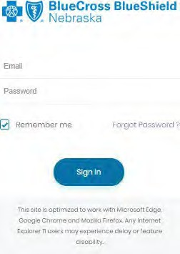
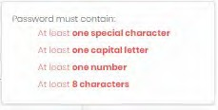
Create an Account
Enter email address
Create a password

Slide 6
Dashboard

Slide 7
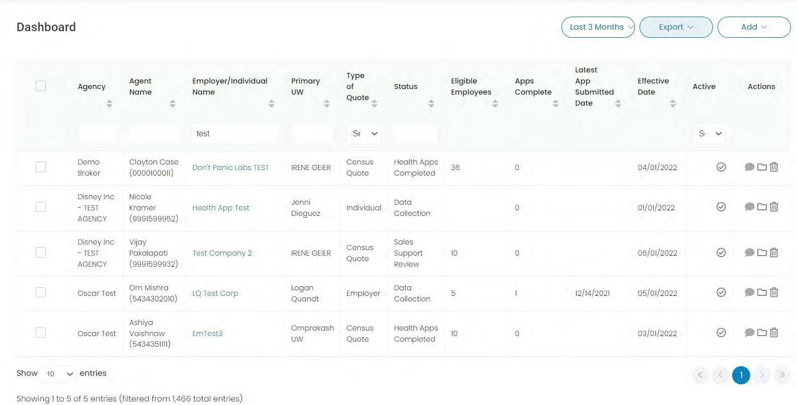
Dashboard
Overview of all groups currently being quoted
First four columns have a search function
Drop downs for search, export and add (employer/individual/census)functions
7

Slide 8
Census Application
Follow these steps for quotes with 10+ enrolling employees

Slide 9
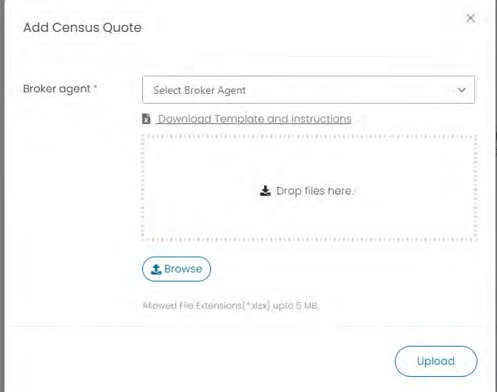
Start Census Quote
1.
2. A box will pop up:
Select the applicable broker/agent in drop-down menu.
The census file can be accessed from NebraskaBlue.com/Brokers or downloaded from the window.

Slide 10
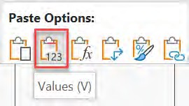
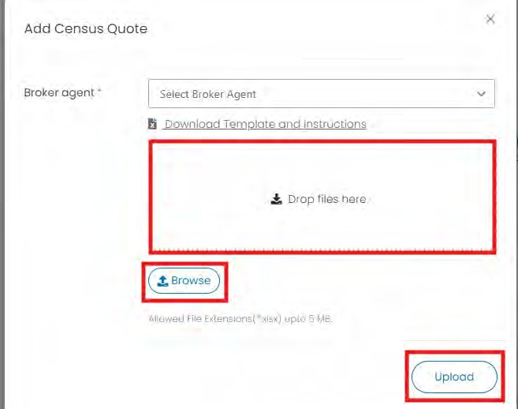
Complete Census Excel File
Follow the tabs and instructions in the Census Template
Complete using the correct cell formatting, ensuring all required fields are completed and all enrolling members are populated.
There have been NO recent changes to the template. The cells will highlight if missing.
If copying from another Excel file, due to formatting, use Right Click - Paste Options – Values:
Save the file to your computer - select the Browse button, attached the groups Census Template and select “Upload.”
OR Drop the file in the box titled “Drop files here”

Slide 11
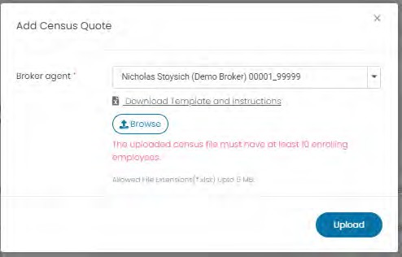
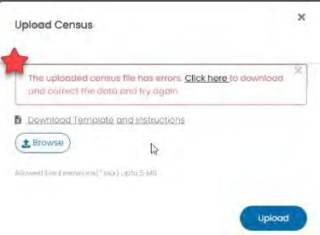
Census Template Validation
Some validation will be automatic once the file is uploaded
1. If there are less than 10 enrolling* employees added, you will see this:
2. If there are errors in the Excel file, you will see this:
*If the group’s total enrollment falls below 10, then health applications will be required
11

Slide 12
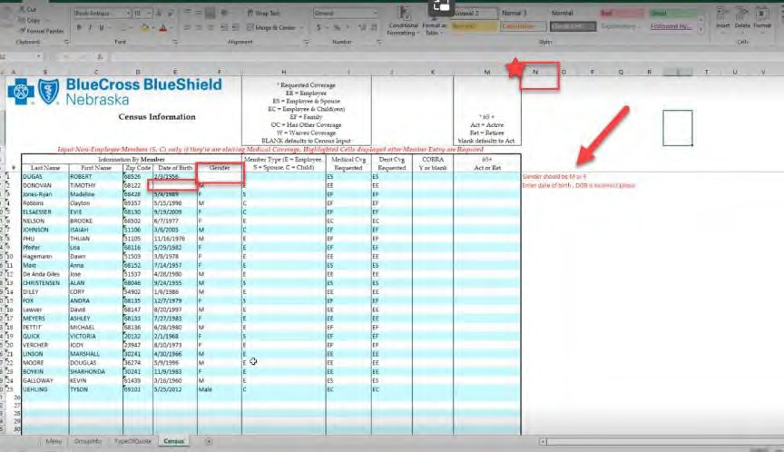
Census Template Errors
1. If you get this error, select “Click here” to download
the error template.
2. On the Census tab, all errors will be noted in the N column. Fix all errors (either on error template or original), save the file and re-upload.

Slide 13
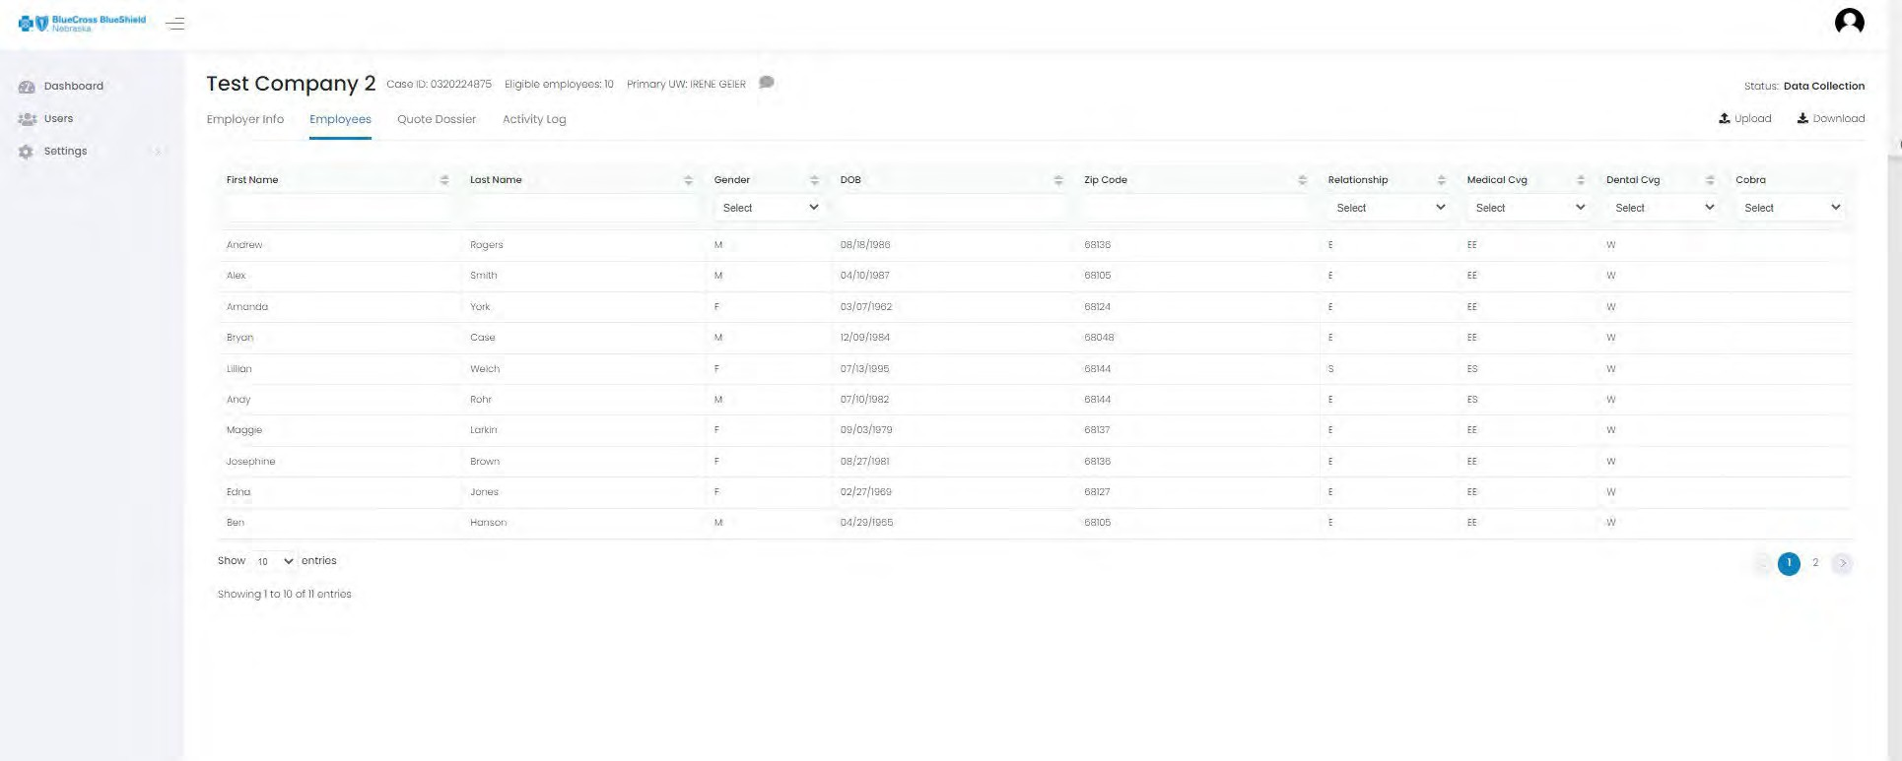
Review
Once the Template is uploaded, the Employer Info and Employees tabs are automatically populated.
From the employee screen, you can upload a new census (if members are added to the group) or download a copy of the census

Slide 14
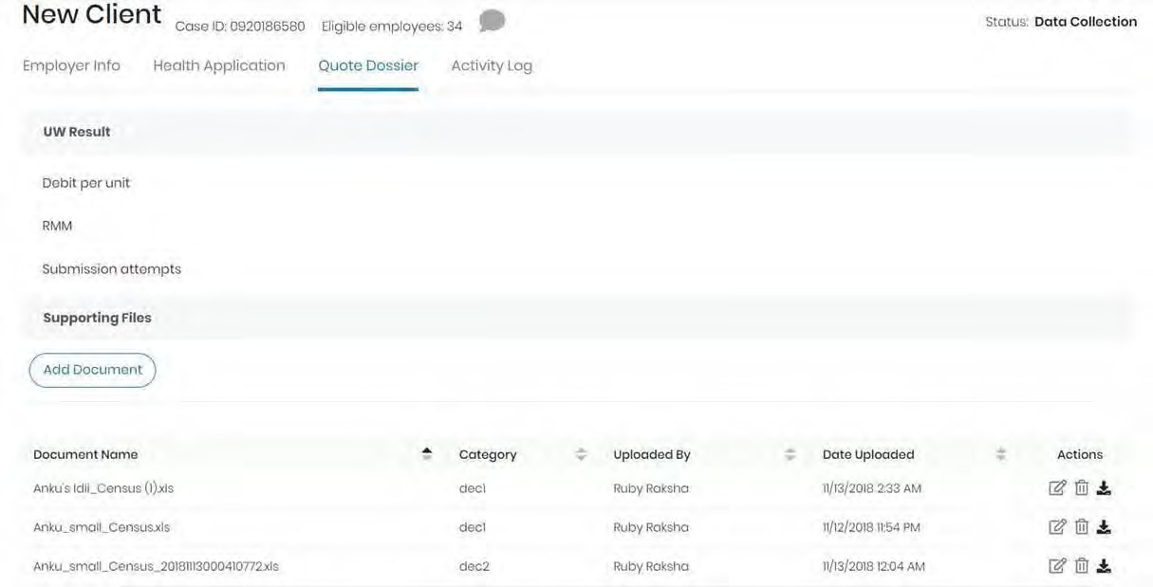
Upload documents
In the Quote Dossier tab, you may add and edit supporting documents.

Slide 15
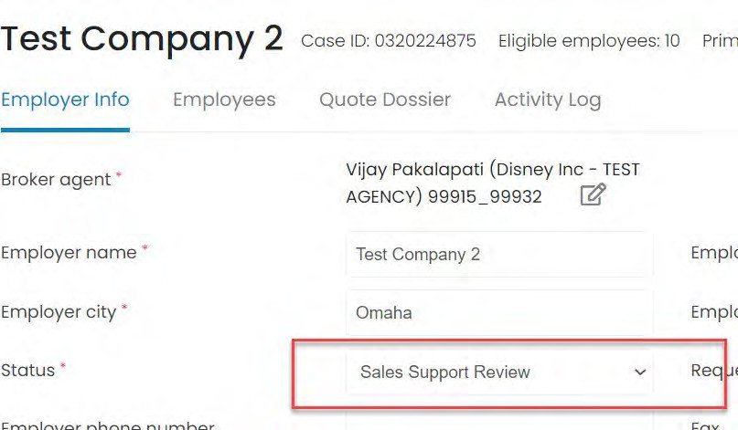
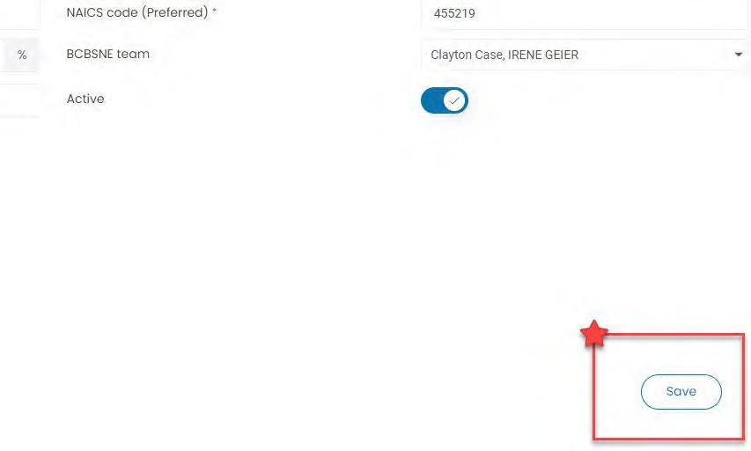
Submit for Review
1. Once all attachments are added and all enrolling members show in the Employees tab, navigate back to the Employer Info tab and select “Sales Support Review” in the status field.
2. Then select the “Save” button in the bottom right corner

Slide 16
Group Setup and Personal Health Apps
Use these steps for quotes with 5-9 enrolling employees

Slide 17
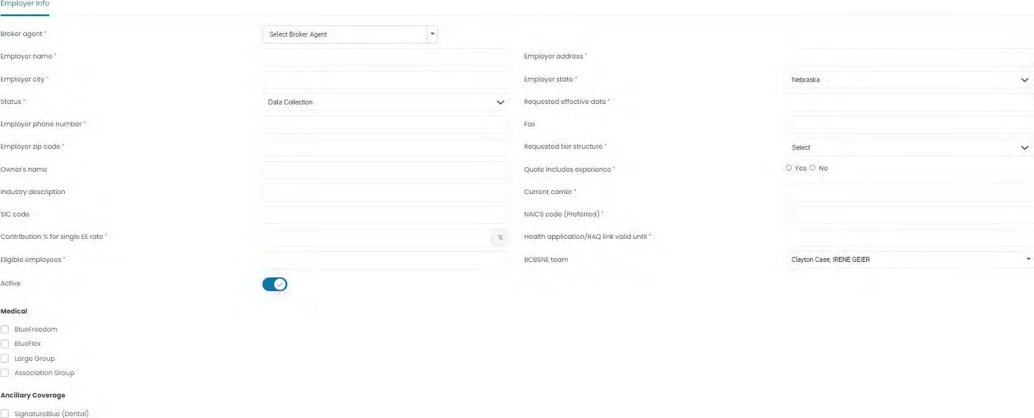
Group Setup
Click “Add Employer” to create a group
Complete all information
* Required fields

Slide 18
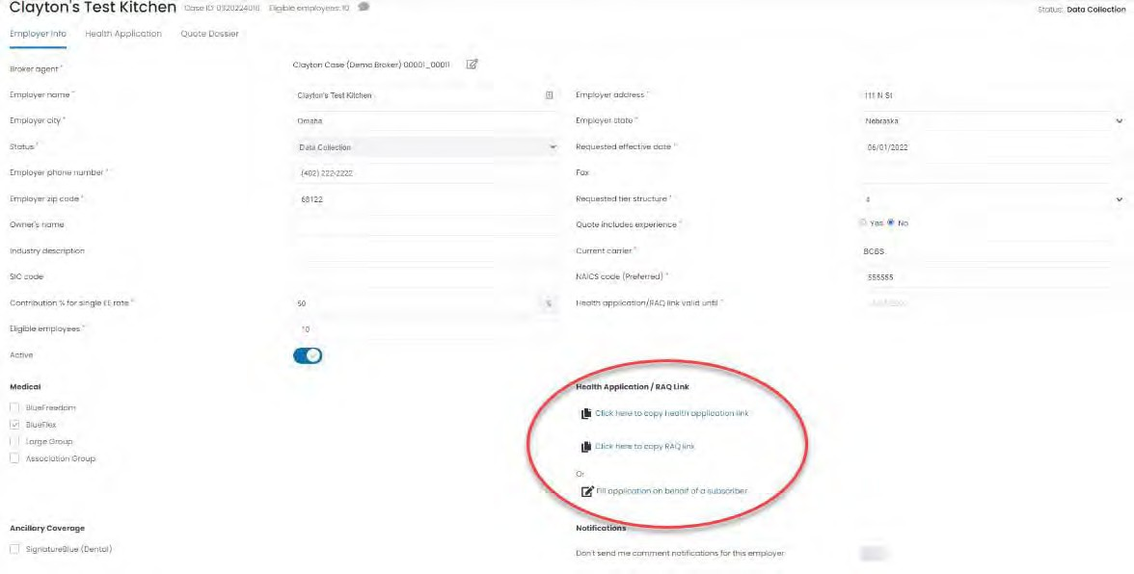
Sending the Personal Health App Link to the Group
Select the “Click here to copy health app link” and email the link to the group
This will allow the group to begin entering their health app data
If the effective date needs to be changed once submitted, please send an email to: newsales@nebraskablue.com with the group name and the new effective date
Use to copy link and email to employee to self-complete health app.
Use if member is unable to complete app and you would like to submit on their behalf

Slide 19
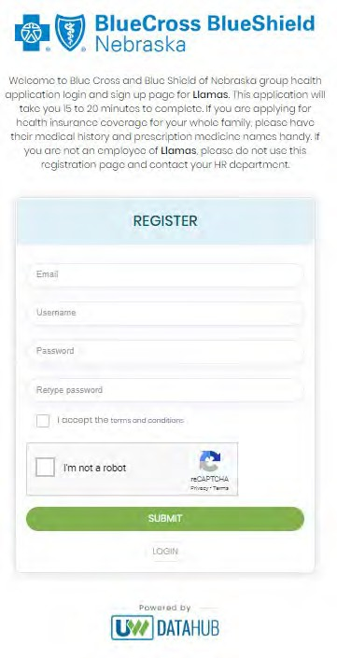
Create an Account
Once employees click the link emailed to them, they will be required to create an account with a username and password to complete their Personal Health App.

Slide 20
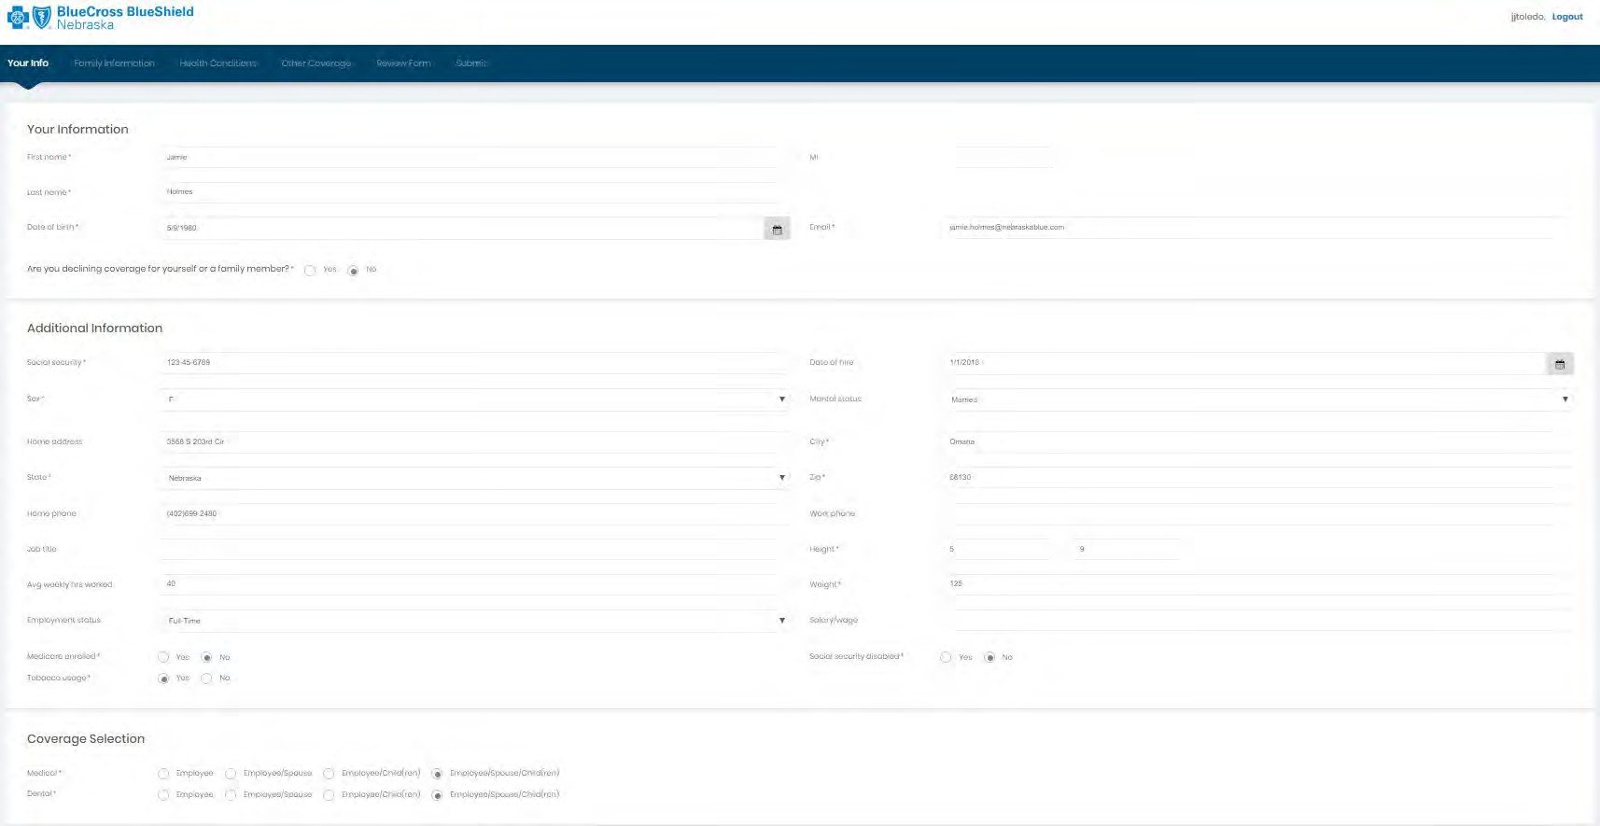
Your Info
Employees inputs their information and coverage selection. Date of Hire is a required field.
All eligible employees will need to complete the individual health app process, even if they have a valid waiver.
If employees decline any coverage, they will need to complete the 'Waiver of Coverage' section that will appear.

Slide 21
Waiver of Coverage
This section will need to be completed if an employee or dependent is waiving coverage.

Slide 22
Family Information
Employee inputs dependent information

Slide 23
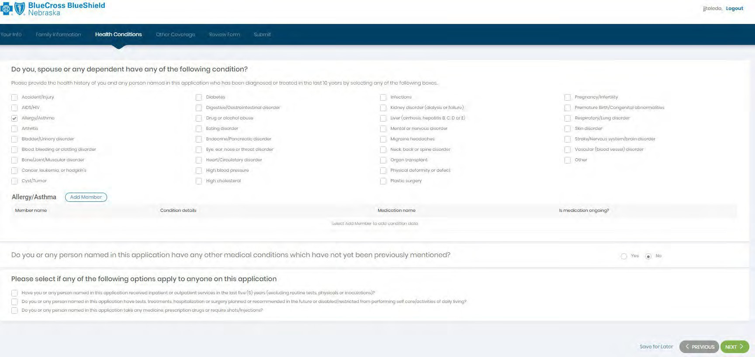
Health Conditions
Employee inputs health conditions for themselves and/or family

Slide 24
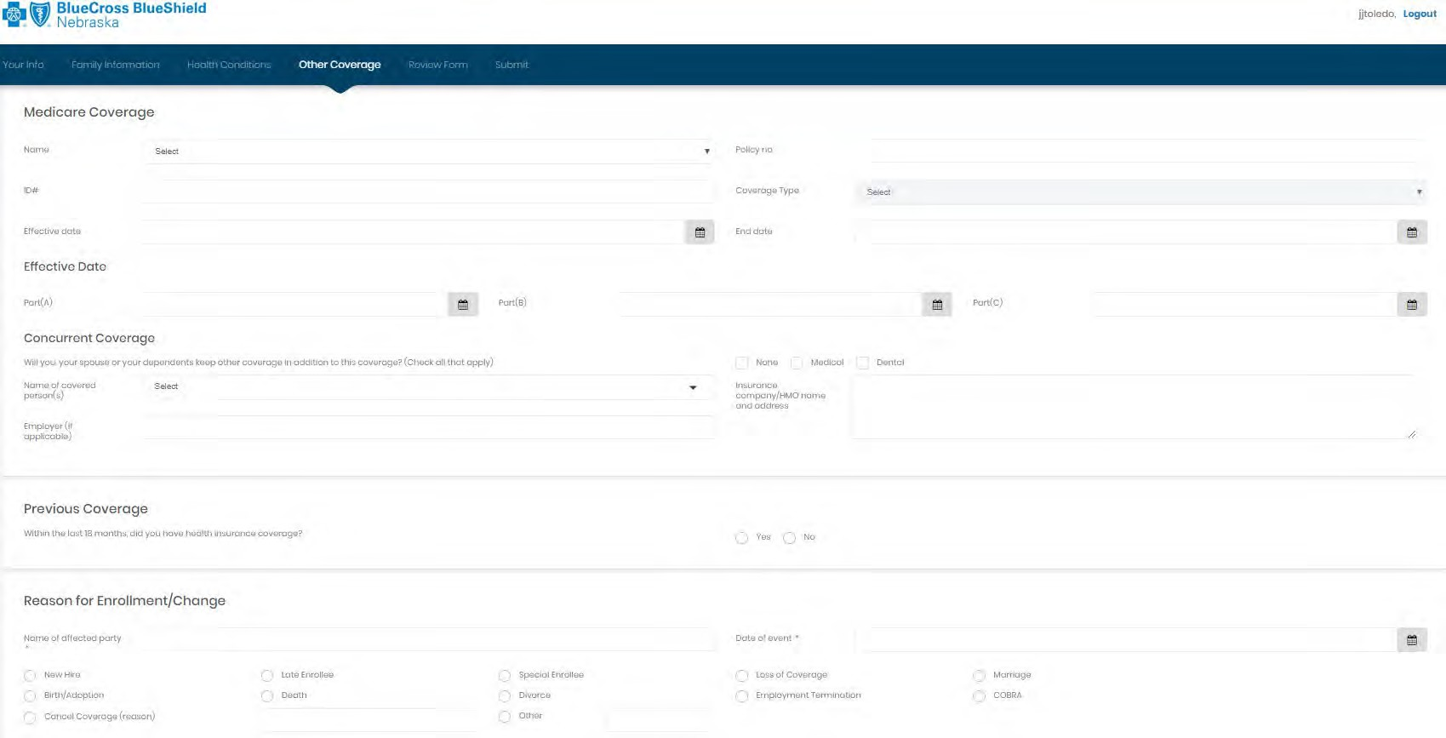
Other Coverage
Employee inputs additional coverage information

Slide 25
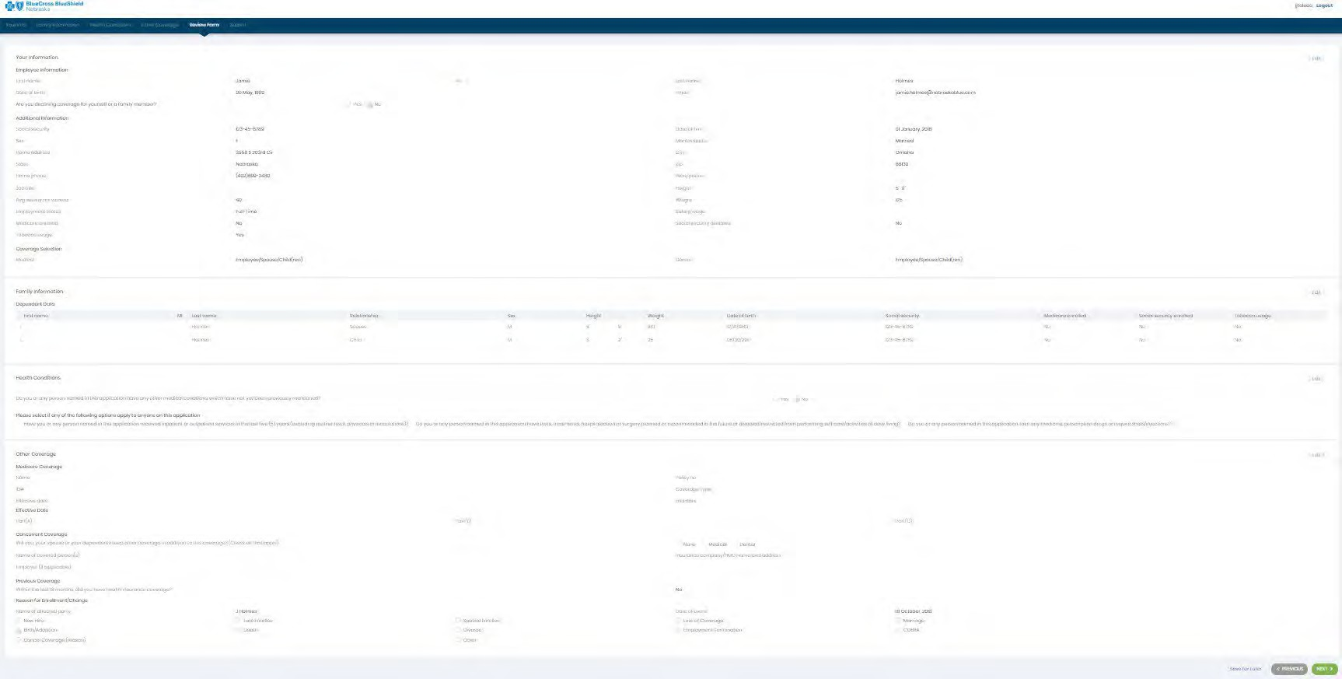
Review Form

Slide 26
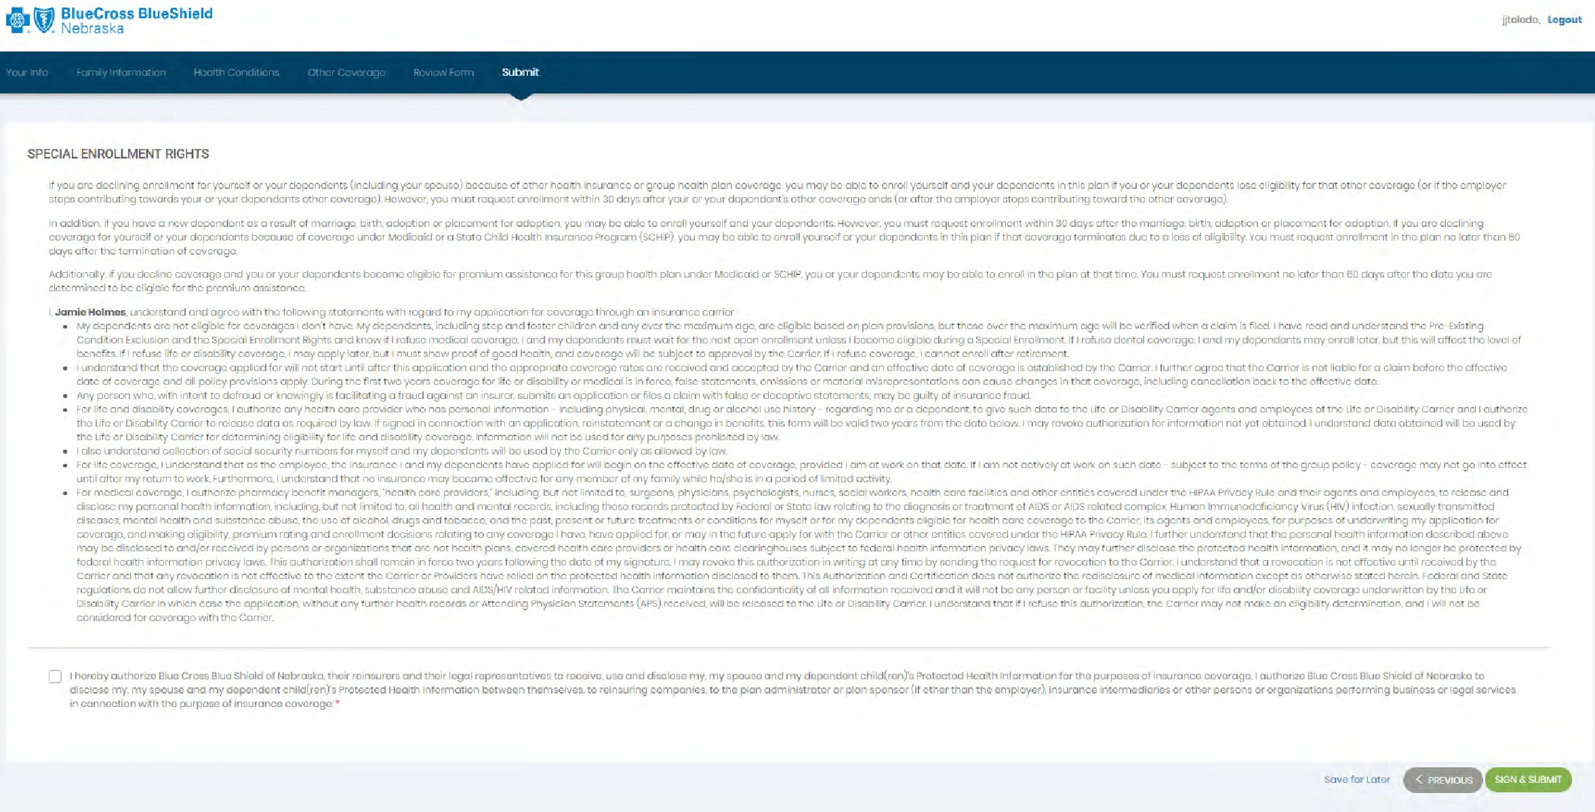
Applicant Submission
If the broker completes the application on behalf of the member, this attestation page will have different language.

Slide 27
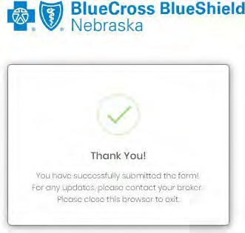
Application Confirmation

Slide 28
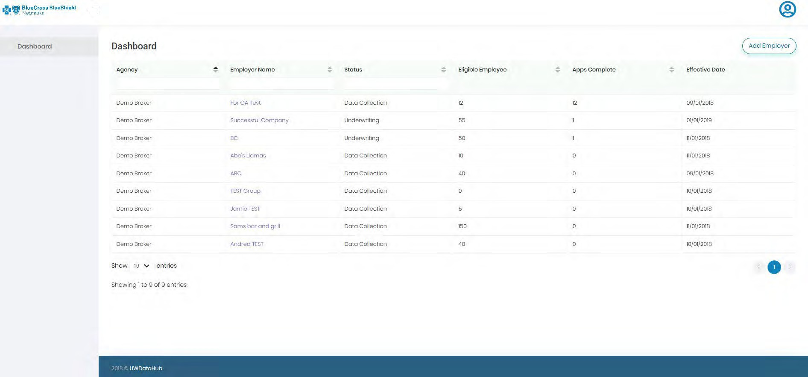
Monitoring completed health apps
Monitor the status of apps with the Eligible Employee and Apps Complete columns.
To view specific employees who have completed the apps, click on the number under the “Apps Complete.”

Slide 29
Submitting Apps to Underwriting
Once the “eligible employee” count matches the “apps complete,” the apps will need to be submitted to Underwriting.
Click on the group name, go to the Health Application tab and click on “Submit to UW.”

Slide 30
Reports

Slide 31
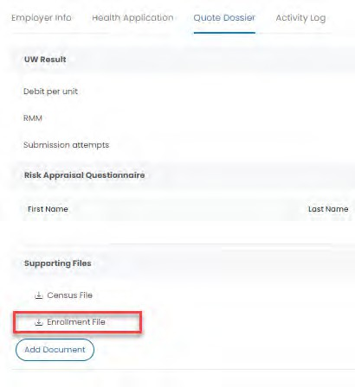
Quote Dossier
Located in the Dashboard under specific group account
Enrollment Report available only if a group is at a status other than “data collection”
Note: the employee must sign and submit the app or it will not appear in the report

Slide 32
Questions
For assistance with application changes or to modify the quote status, please do the following:
New business quotes, email NewSales@NebraskaBlue.com and carbon copy your Sales Executive. Current BCBSNE group quote, please contact a member of your account team.

Slide 33
THANK YOU FOR YOUR TIME

