Slide 1
AAHAM Kearney, NE 2025 Spring

Slide 2
Mission and Values

Slide 5
Meet the Team
Notes:
We’ve had a few shifts in team alignments so we wanted to pass along the updates in case you weren’t aware.

Slide 6




Provider Operations Leadership
CINDY DALY
Director of Claims & Provider Relations
HEATHER FUEHRING
Mgr. Provider Relations
Notes:
We thought we’d share Heather & Cindy’s pictures as well. Heather has been the manager for our provider relations team for the last 2 ½ years. Cindy is our director of claims but has recently acquired responsibly for the provider relations teams as well. Dana is still with us and here today but in a new role to support our provider partnerships.
Our Provider Relations teams are aligned to give support to all providers in the state. Providers should always self-serve via NaviNet and utilize the claims investigation option before reaching out to CSC. Our new dynamics tool is designed to route your questions to the Provider team should CSC feel an escalation is warranted.

Slide 7




Provider Relationship Executives
Jennifer drew
Providers, Specialties and Dentists: ZIP codes starting with 688, 689, 690, 691, 692, and 693
Temporarily Supporting Methodist Health Partners
Jessica bailey
Providers and Specialties:
Bryan Health, Bryan Health Connect, Common Spirit Health, National Providers and UniNet Temporarily Supporting Madonna, Nebraska Medicine and Nebraska Health Partners
KATHERINE VRBKA
Providers, Specialties and Dentists:
ZIP codes starting with 684, 685, 686, 687 and Veterans Administration
Tawny archer
Providers, Specialties and Dentists:
ZIP codes starting with 680, 681, 683, Boys Town, Children’s Nebraska and Secure Care
Notes:
We thought we’d share Heather & Cindy’s pictures as well. Heather has been the manager for our provider relations team for the last 2 ½ years. Cindy is our director of claims but has recently acquired responsibly for the provider relations teams as well. Dana is still with us and here today but in a new role to support our provider partnerships.
Our Provider Relations teams are aligned to give support to all providers in the state. Providers should always self-serve via NaviNet and utilize the claims investigation option before reaching out to CSC. Our new dynamics tool is designed to route your questions to the Provider team should CSC feel an escalation is warranted.

Slide 8




Provider Relationship Executive Support Specialists
Cache butt
Providers, Specialties and Dentists:
Madonna Nebraska Health Partners
SHAWNTEL HOLMES
Providers, Specialties and Dentists:
Methodist Health Partners Common Spirit Health
LISA REW
Providers, Specialties and Dentists:
ZIP codes starting with 680, 681, 683, Boys Town, Children’s Nebraska and Secure Care
Cayla kelly
Providers, Specialties and Dentists:
ZIP codes starting with 684, 685, 686, 687, 688, 689, 690, 691, 692, 693 Veterans Administration
Notes:
Providers are encouraged to ONLY use the Provider Execs email when they have a true escalation. Our teams have experienced quite a backlog due to emails being sent to this mailbox that are not escalations. Examples: credentialing status questions; provider data questions; timely filing status questions; etc. Credentialing status should be done through CAQH or by following the manual steps on our credentialing page. To check on provider updates (add a provisional provider, update EFT, ERA or terminate a provider or location emails should be sent directly to HealthNetworkRequests@NebraskaBlue.com
Our Provider Support Team Members to assist in our efficiency. Cache, Cayla, Lisa and Shawntel work closely with our teams (CSC, claims, etc.) to ensure escalations are handling appropriately. If we do find providers are bypassing steps, don’t be surprised to have that email be routed back. Like we said, incorrect use of the provider execs email has led to a large backlog preventing us from addressing true escalations and trends timely.

Slide 9
NaviNet®

Slide 10



Third-Party Registration
Provider Academy
You will find the below information and links under our Provider FAQ’s page under the first section called NaviNet FAQs. https://www.nebraskablue.com/en/Providers/Provider-Academy/Provider-FAQs/NaviNet-FAQs
Am I required to use NaviNet as a third-party vendor?
Yes, all in-network providers, as well as the vendors supporting them, are required to use NaviNet for claims, benefits and other questions.
What if I work as a vendor for a provider office and/or facility? Or how do I get my third-party vendor registered?
Visit the NantHealth Help Center to register as a third-party with NaviNet and follow the steps on the page.
As a vendor do I have to complete a form on NavINet?
All third-party vendors need to complete the Authorization form to register with NaviNet, or to add tax IDs or health Plans.
NaviNet® is a healthcare provider portal providing services for Blue Cross and Blue Shield of Nebraska.
Notes:
It's important if you have a third party biller to follow these steps to ensure they are getting the proper permissions for your Tax ID.
The link on how to sign up your third party can be found on our Provider Academy under Provider FAQ's page under the first section called NaviNet FAQs.
Please follow the instructions on the link as your Third Party will need to complete the Authorization form with NaviNet to have access to your Tax ID.

Slide 11



Claim Appeals
Appeal
Denied Not Medically Necessary
Denied Experimental or Investigative
Denied No Preauthorization Obtained
Contract Exclusion or Duplicate Service
High Dollar Prepayment Review
Cosmetic
Fertility
Routine vs Medical
Assistant Surgeon
Reconsideration
Manufacturers Invoice for Pricing
Other Insurance Information Coordination of Benefits (COB)
Coordination of Benefits (COB) Timely Filing Disputes
Billing or Coding Dispute with Medical Rationale
Copy of Medical Records
Subrogation or Workers’ Compensations
Subrogation or Workers’ Compensations Timely Filing Disputes
Timely Filing Form
Member ID card was not obtained
Total Obstetrical (OB) care
BCBSNE Processing Timely Filing Disputes

Slide 12
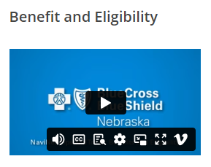
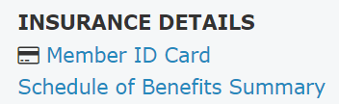
Eligibility and Benefits
BCBSNE Members
Bluecard Members
Member ID
Is optional, the active plan will display when searching by name and DOB.
ID Cards
Copies of ID Cards are in NaviNet. Under Insurance Detail.
Schedule of Benefits Summary
Is also located under Insurance Detail.
Medical and Dental is available. Dental is on the bottom if members have both Medical and Dental.
If member’s policy is terminated the Schedule of Benefits Summary will not open.
Member ID
Is required to search in NaviNet.
We receive limited data directly from the member’s home plan regarding their eligibility and benefits.
For detailed eligibility and Benefits you can call the member’s home plan directly with the number on the back of their ID card or BlueCard Line at 1-800-676-2583
ID Cards
Copies of ID Cards are not loaded in NaviNet as they are not our members.
Schedule of Benefits Summary
Schedule of Benefits Summary are not loaded in NaviNet as they are not our members.
Please visit our eLearning page on Provider Academy for a video on step-by-step instructions on Eligibility and Benefits.
NebraskaBlue.com/Providers/Provider-Academy/eLearning
Notes:
We do have a video on step by step instructions on how to find Eligibility and benefits located on our Provider Academy.
BCBSNE Members are our members and we house their Eligibility, benefits, and Medical Policies. You can look up a BCBSNE Member without their Member ID, unless they have two polices with BCBS.
Copies of their ID cards are also located under Insurance Details.
Their Schedule of benefits summary are also located under Insurance details.
Please note for Dental providers: If the member has Dental Benefits through BCBSNE their benefits will be located under The Schedule of Benefits Summary. If they have both Medical and Dental, dental will be at the end of the document.
This is a good reminder that BlueCard (other plans) are not our members. We do not house their Eligibility, benefits, and Medical Policies. Benefits can be loaded out here for BlueCard members, but can be limited as we receive the information directly from the home plan. This is why we do not have copies of the ID cards or their Schedule of Benefits Summary. It's always a good Idea to reach out to the member's plan directly or BlueCard Line for Eligibility, Benefits, and what needs a preauthorization. The BlueCard telephone line is 1-800-676-2583.
If you need additional information on how BlueCard works, please visit our Policies and Procedures on our Website WWW.Nebraskablue.com/Providers and type in Bluecard under the search box.

Slide 13
Pop Quiz
1. True or False - Member IDs are required to search for member eligibility and benefits on NaviNet.
Answer: False
2. When a claim denies for timely filing due to another payor, what is the correct form to use?
Answer: Reconsideration Form
3. An incorrect CPT code was included on the claim. Which form should I use to correct this?
Answer: You don’t need a specific form. Instead, submit a corrected claim, including the claim frequency type code and the original claim number. Please refer to GP-X-039 Corrected Claims for more information.

Slide 14
Medicare Advantage

Slide 15
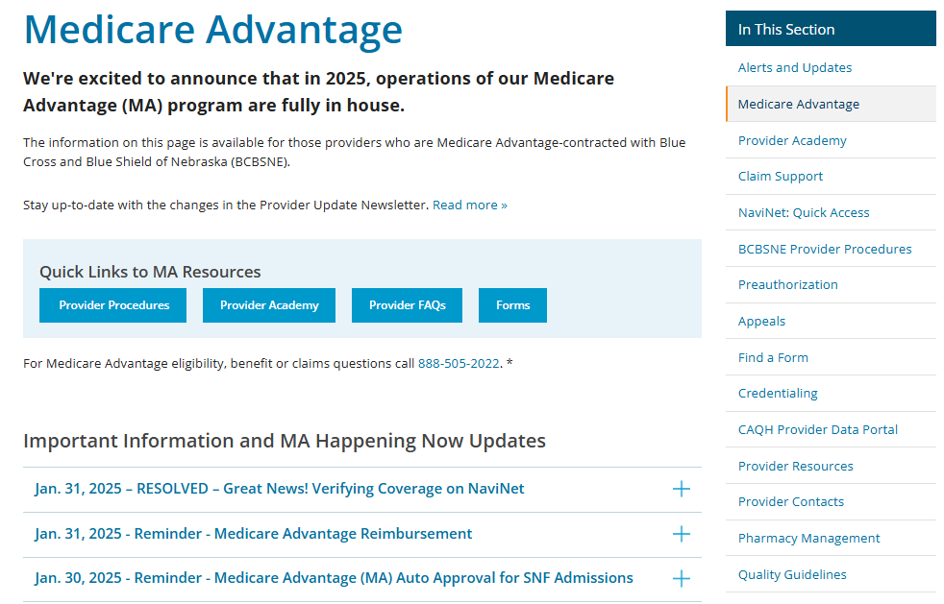
BCBSNE Medicare Advantage Resources
Access a variety of information on the BCBSNE Provider MA site including:
Updates
Communications
Procedure manual
Notes:
Jennifer: remind providers of the auto-approval for seven days in SNF or Swing Bed

Slide 16
Join Us at our in-person Medicare Advantage Provider Forum in Kearney
You’re Invited!
Date: July 15, 2025 Time: 8 a.m. - 4 p.m.
Location: Holiday Inn Hotel and Convention Center 110 Second Avenue, Kearney, NE 68847 Contact: (308) 237-5971
Join us for a day of insightful discussions and networking. A light breakfast and lunch will be provided.
Need a room for the night before? We have a special group rate of $139.95 (plus taxes and fees) available on Mon. July 14 for forum attendees.

Slide 17
Value Based Care

Slide 18





What is Value Based Care?
Emphasizes integrated care, addressing physical, mental, behavioprovidersral, and social needs.
Pays based on outcomes, rather than individual tests or services.
Considers an individual's personal health goals.
1
Improve health outcomes
Improve quality of care and patient experiences​
2
3
​Lower costs
18

Slide 19
Value-Based Care Models
We partner locally with primary care physicians to support better health and cost outcomes - mutual accountability
Non-value-based
Value-based: Upside Only
Value-based: Downside Risk
Fee for Service Only
Quality Bonus
Shared Savings
Shared Savings / Shared Costs
Capitated by Patient
No Risk
No Risk
Increased Risk
Increasing $$ Opportunity
High quality performance
Care management requirement​s
Financial Accountability
High quality performance
Care management requirement​s
19

Slide 20

How We Work Together
Shared goals and outcomes
Focus on preventive medicine and management of chronic conditions
Better access to care and member experience
Shared financial responsibility to Lower cost growth
Sustainability
Sizable attributed populations
Provide options to meet providers at different levels of readiness to effectively manage risk
Incentivize care transformation, efficiency, and high-quality care
transparency
Share best practices and provider education
Share Data and Analytics of Attributed Members
Provide support with case management and care coordination activities with BCBSNE teams
Meet Frequently to review program performance
For further inquiries regarding our VBC program, please contact us at
VBPQuestions@NebraskaBlue.com

Slide 21
TriWest

Slide 22
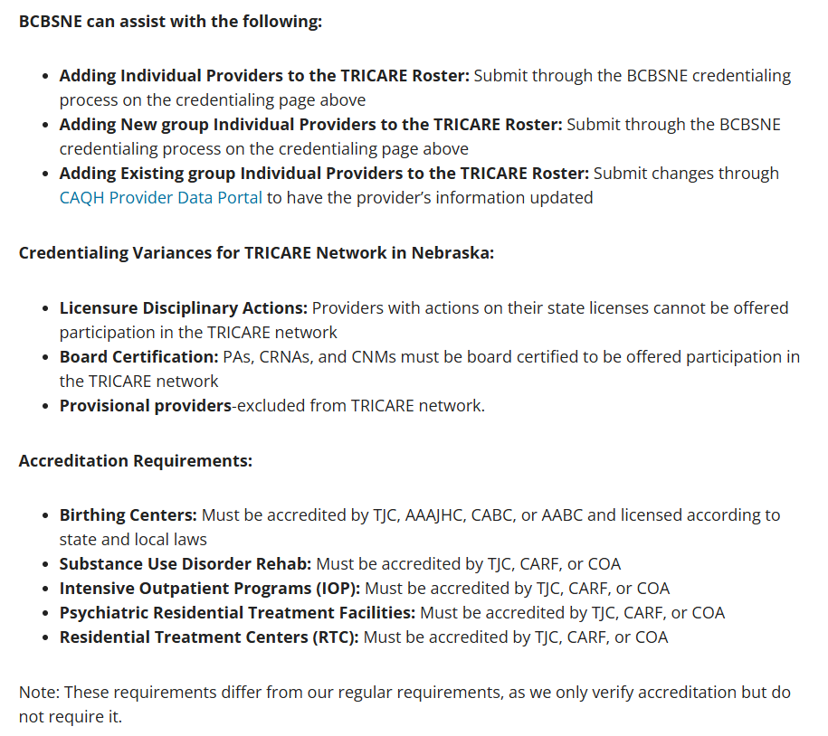
TriWest Resources
TriWest Provider Resources document
Fax: 866-852-1893
(for same-day, urgent referrals, fax
detailed information)
Provider Services Email:
providerservices@TriWest.com
Provider Page:
Welcome TRICARE West Providers
Fee Schedule:
CHAMPUS Maximum Allowable Charge Rates | Health.mil
Reimbursement Manuals:
TRICARE Manuals - Home

Slide 23
Communications and Resources

Slide 24
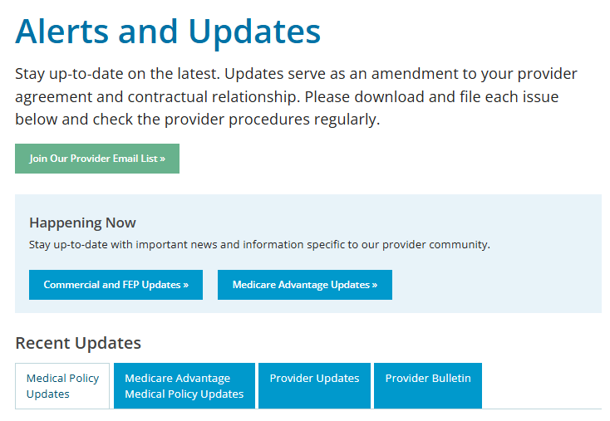
Alerts and Updates Join our Provider Email list (receive an email when a new issue of Provider Bulletin or Provider Update is available) Happening Now (Commercial and FEP Updates and Medicare Advantage Updates) Provider Bulletin (monthly) Provider Updates – extension of your contract (bi-monthly newsletter)
Alerts & Updates for Providers | BCBSNE
Notes:
We have multiple ways to get the latest news and updates from our team. Make sure you are signed up for our bulletins and newsletters!

Slide 25

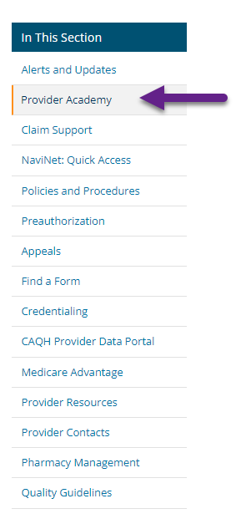
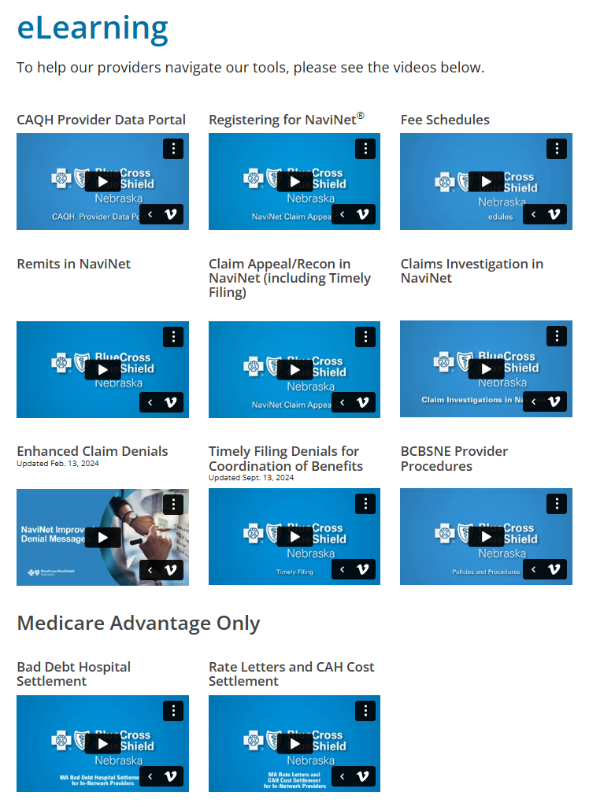
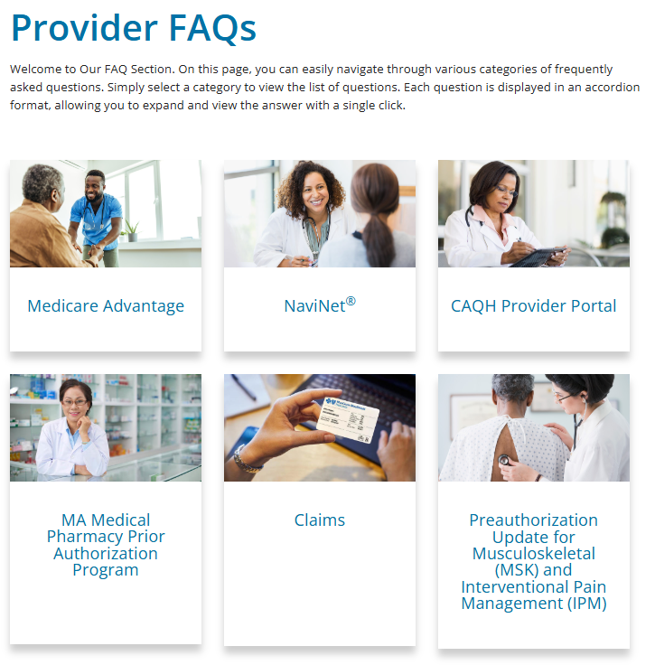
Provider Academy Provider Academy | BCBSNE
Notes:
We continue to add new information and update our provider academy page to better serve and educate.....
There are three sections within our Provider Academy that we will go over now.

Slide 26
Questions
Thank you for your time

