Slide 1
Planning for 2022
Your Provider Executives
January 28, 2022

Slide 2


Alerts and the Monthly Update Newsletter
Stay up-to-date on the latest updates and/or changes
The Update newsletter serves as an amendment to your provider agreement and contractual relationship
Please file each issue received and keep it with your policies and procedures manual
You may download and/or sign up for the newsletter at NebraskaBlue.com/Provider-Update
The Provider Executive (PE) team sends out a monthly email blast; each out to your PE to be added to the list
Notes:
Welcome to the first in a series of provider webinars in 2022. Our goal this year is to provide information through webinars and brief educational videos. These webinars and videos will be available on the Webinars page on nebraskablue.com.
As we begin a new year, this webinar has been designed to keep providers informed of changes that took effect the first of the year as well as review of processes that are not changing.
These are the changes that we feel are important to know. Not all changes in 2022 will be captured in this presentation. Please continue to review the bi-monthly Update newsletter. If you are not receiving an email when a new issue has been published, you are encouraged to sign up to receive those notifications. The link to the sign-up page is on this slide.
To supplement the information in the Update newsletter, the Provider Executive team also sends out monthly email blasts on hot topics, emerging news, resources and so on. If you would like to receive these email blasts, please email your Provider Executive.
Feel free to share the newsletter or email blast with others at your organization who may benefit from the information – patient registration, scheduling, quality and so on.

Slide 3
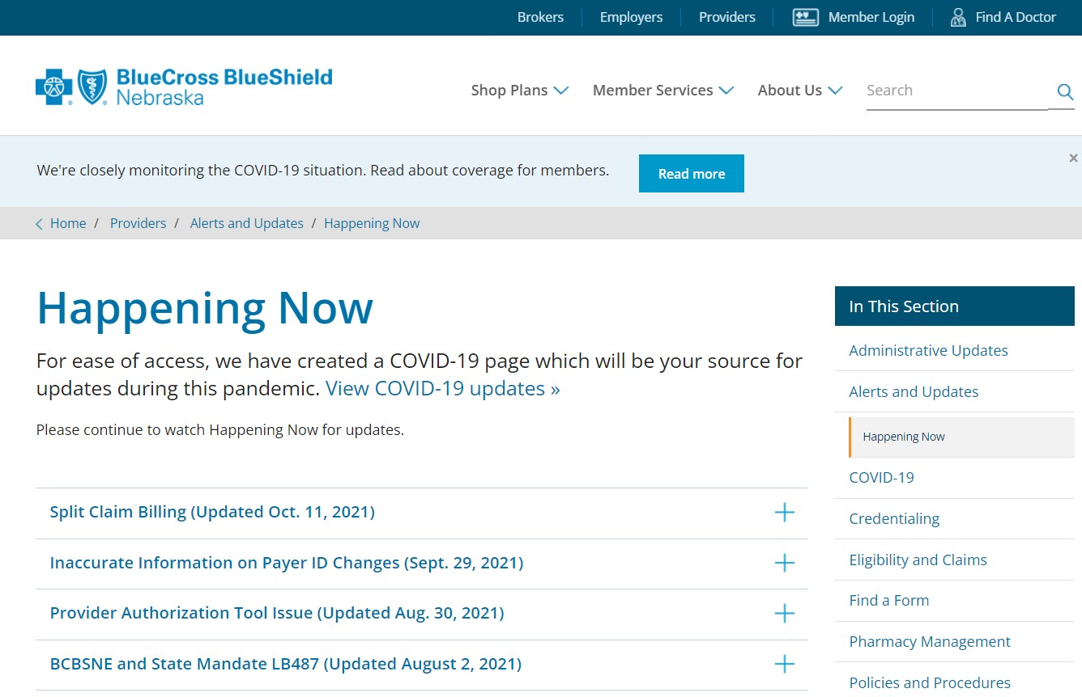
Happening Now
1
Link on the BCBSNE website at NebraskaBlue.com/Happening-Now
Some topics include:
    Telehealth and addition of POS 10 – effective April 1, 2022
    Split Claim Billing into 2022
    Process Change to MUE
    Provider Level Adjustments
    Taxonomy Code Required on All Claims
Visit this page often for up-to-date information
2
3
3
Notes:
The Happening Now page is an important part of our communication.
Happening Now is used to communicate important information for topics that need to be shared in between publications of the Update newsletter.
Urgent information that needs to be shared is published on this page and should be referenced often.

Slide 4
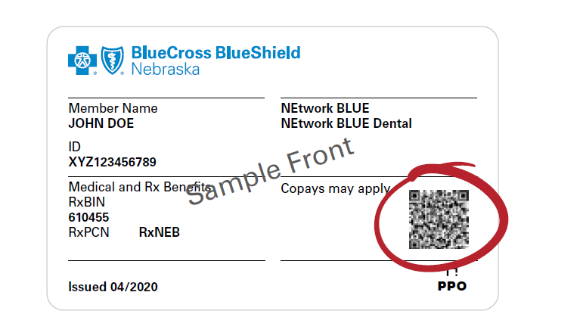
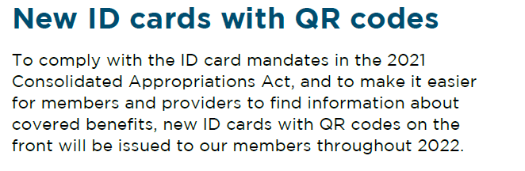
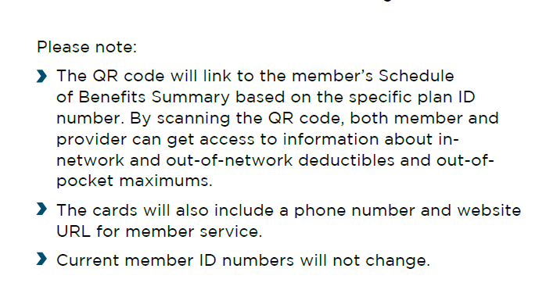
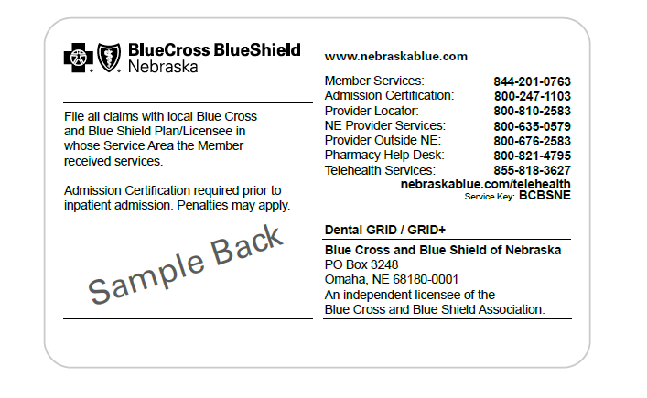
4
Notes:
To comply with the ID card mandates from the 2021 Consolidated Appropriations Act, new ID cards for BCBSNE members will be issued throughout 2022 upon the group’s renewal.
Member ID numbers will stay the same for existing BCBSNE members.
New ID cards will include a QR code which will link to the member’s Schedule of Benefits summary.
If the QR code is scanned and the member’s policy has termed or otherwise not active, the statement of “We are currently unable to provide information for this QR code” and a message to contact us will appear on the screen.
Not all BCBSNE cards will be reissued with a QR code. BCBSNE ID cards that will not contain a QR code include Medicare Supplement, dental only policies, and contraceptive only policies.

Slide 5
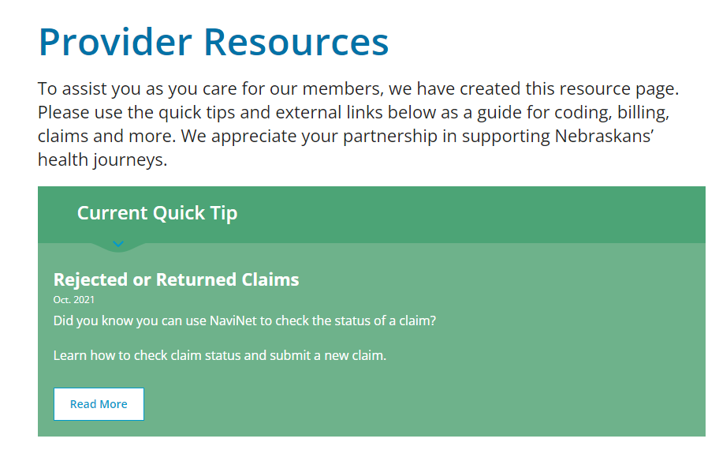
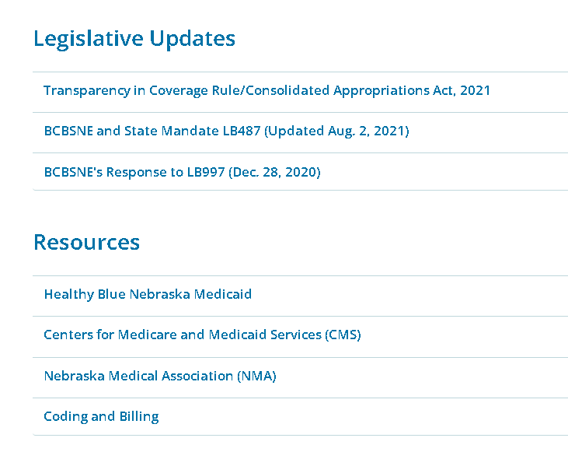
NebraskaBlue.com/Providers/Provider-Resources
5
Notes:
The recently added Provider Resources page on nebraskablue.com contains current quick tips, legislative updates and resources.
Quick Tips will be updated routinely. To find older tips, these tips can be accessed on this page in the archived section that will be available once more quick tips are added.

Slide 6
Legislative Updates
Transparency in Coverage Rule (TCR)
Consolidated Appropriations Act, 2021 (CAA)
  No Surprises Act
  LB997
Key components of TCR
Encouragement to consumers to shop for services
Public disclosure of rates in machine-readable files
Personalized disclosure of out-of-pocket costs
Key components of CAA
Price comparison tools
Advance EOBs
Surprise billing
Air ambulance
Provider directories
Mental health parity
Changes to member ID cards
Broker and consultant compensation disclosure
6
Notes:
The Transparency in Coverage Rule (TCR) was released in October 2020. In December 2020, the Consolidated Appropriations Act, 2021 (CAA) was signed into law..
The TCR is designed to make health care price information more transparent for consumers. The provisions include:
Making certain cost and claims data available through posted machine-readable files
Establishing an internet-based, self-service tool to allow members to get real-time, accurate estimates of cost-sharing liability for specific services, furnished by specific providers, at specific locations
The CAA includes funding for COVID-19 relief, as well as various other provisions such as health care-related mandates to protect consumers. The provisions include:
Ending surprise medical bills, including those for air ambulance services
Increasing transparency for group health plans, including added language on insurance cards, advance explanations of benefits (EOBs), price comparison tools and up-to-date provider directories
Ensuring continuity of care when a provider or a facility leaves a network
Strengthening mental health and substance use disorder parity requirements
Requiring reporting for pharmacy benefits and drug costs

Slide 7
Legislative Updates
  No Surprises Act
  LB997 (Nebraska’s Out-of-Network Emergency Medical Care Act)
No Surprises Act - Effective Jan. 1, 2022
Protects consumers from getting surprise bills
from out-of-network providers or facilities
Emergency situations (emergency and related
post-stabilization services)
Non-emergency services provided by a non-participating provider in a participating facility
Air ambulance services (ground ambulance
not included)
LB997 (Nebraska’s Out-of-Network Emergency Medical Care Act) - Effective Jan. 1, 2021
Keeps consumers from getting surprise bills from out-of-network providers or facilities for emergency medical services
Providers in Nebraska may not balance bill patients for medical care receive from out-of-network providers or facilities in emergency situations
7
Notes:
Effective Jan. 1, 2022, out-of-network providers will receive remits and payment for their claims when the situation falls in one of the above scenarios. This also applies to providers who are out-of-network with one of the narrow networks of Blueprint and Premier Select.
Out-of-network providers cannot balance bill patients, although certain providers can continue to balance bill if they give the patient notice of their network status and an estimate of charges 72 hours prior to receive out-of-network services. The patient must also give consent to receive out-of-network care.
The No Surprises Act does not apply to individuals with any of these policies: Armor Health, Medicare Supplement, Medicare Advantage and dental.
Another key component of the CAA is that out-of-network emergency services, including services excluded by the plan, will be covered. An example of that is dependent daughter maternity.

Slide 8
Preauthorization Tool
Available on NaviNet, as of Jan. 2021
Tip:
If your provider is in the process of being loaded but you need to submit an authorization:
Submit like any other outpatient procedure, as we preauthorize the procedure and not by whom it is performed
A note can be added within the tool on the notes page for the actual provider's name
Confirm an active request for the provider load has been received
  FAQ available at:
  MedicalPolicy.NebraskaBlue.com/FAQ
Questions?
ProviderPortalAuthQuestions@NebraskaBlue.com
Call: 800 247 1103 option 5
Notes:
One of the tools that is not changing in 2022 is the preauthorization tool available in NaviNet.
Submitting a preauthorization request via NaviNet is the most efficient way to expedite a preauthorization.
This tool gives you access to your own dashboard to check the status and progress of your preauthorization and precertification requests.
If a preauth is submitted by non-clinical staff, the preauth can be saved if clinical information is needed. BCBSNE will not see draft requests until the authorization has been completed and submitted.
Several BCBSNE medical policies have been updated for a Jan. 1, 2022 effective date. Please make sure to review the medical policy update letters that your provider receives on a quarterly basis for current changes.

Slide 9

A COVID-19 page and FAQ was developed with up-to-date information and links to CMS and other resources.
Be sure to check this page routinely for the latest information:
NebraskaBlue.com/Providers/COVID-19
  Some of the current topics include:
    Additional providers during pandemic
    COVID-19 Testing
    Telehealth Claims
COVID-19
BCBSNE led the way in assisting providers during the pandemic
9
Notes:
Our COVID-19 page on nebraskablue is also a place to find urgent information on anything related to COVID-19.
Be sure to check this page routinely for up-to-date news on how BCBSNE is addressing COVID-19 issues and changes.
Current topics include additional providers during the COVID-19 pandemic, COVID-19 testing, telehealth, Ivermectin and many more topics.
Telehealth continues to be available to members in 2022. For the complete list of provider types eligible to provide services via telehealth and the codes that can be billed via telehealth, please see the topic of Telehealth in the General Provider Manual on nebraskablue.

Slide 10
COVID-19 and Preauthorizations
  Changes in effect Aug. 2021 until further notice
Available on NaviNet
Acute Inpatient and SNF Admissions
Preauthorization not required for acute inpatient and mental health inpatient admissions
Preauthorization is required for residential treatment center admissions
Skilled nursing admissions: 1-5 days at a SNF will be approved; additional days beyond 5 will require medical necessity review.
Preauthorizations
Extended approval dates for a previously approved preauthorization due to COVID-19 precautions
When requested by the ordering provider, BCBSNE will allow an additional three months
Please contact Health Services Programs at 800-247-1103, option 7 to begin the process
An updated letter will be sent to the member, provider and rendering provider (if applicable)
Notes:
Because of the ongoing COVID-19 pandemic, prior authorization changes that were initiated in 2021 will continue on into 2022 and until further notice.
Prior authorizations for acute inpatient admissions will not be required until further notice. We ask that our hospital partners notify us of all admissions through the new tool so we can assist with discharge planning and refer members to our care management programs
Skilled nursing admission up to 5 days will be approved. Additional days will require a medical necessity review.
Prior authorizations for certain required types of care, services and items require prior authorization before they are performed. Care, services and items that need prior authorized can be found in the online medical policy tool at nebraskablue. Because of the pandemic, BCBSNE is extending the approval dates for an already approved prior authorization up to an additional 3 months when requested by the ordering provider.

Slide 11
Virta
New Type 2 diabetes reversal program
Beginning Jan. 1, 2022
Virta is a provider-led, research-backed treatment program that can help reverse type 2 diabetes
BCBSNE members may participate in the Virta program at no cost
When a patient has been enrolled, the PCP will receive notice within 14 days of the patient’s enrollment; then monthly notices until patient is no longer enrolled
Notes:
Beginning Jan. 1, 2022, BCBSNE began offering Virta type 2 diabetes reversal program at no cost to our members.
This program offers members an option to members to get off their diabetes medications safely and sustainably. Virta is a provider, licensed in 50 states that complements care from the primary care physician.
Virta is a provider-led, research-backed treatment program that can help reverse type 2 diabetes. Patients can lower their blood sugar and A1c, all while reducing the need for diabetes medications and losing weight.
To get started, members who are interested in this program reaches out to Virta. If the member is a good fit for the program, the member will be enrolled.
The member’s primary care physician will be notified on the patient’s care on a retroactive basis. The primary care physician will receive an initial notice when the patient is enrolled in the program within 14 days, then monthly until the patient is no longer enrolled.

Slide 12
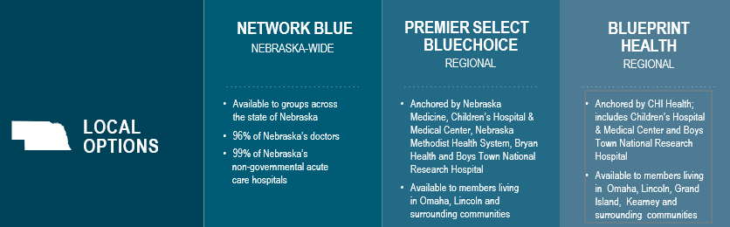
Networks
Notes:
Aside from additional tiered networks, there aren’t any changes to networks.
The statewide PPO is NEtwork BLUE. Contracting providers are in-network with NEtwork BLUE.
There are the two regional networks (also known as narrow networks), Premier Select BlueChoice and Blueprint Health. Contracting providers who wish to be considered for either of these networks will need to reach out to their Provider Executive. For Premier Select BlueChoice, only mental health providers in Douglas and Sarpy counties can request a contract.
Providers also the option to join the Medicare Advantage network. Please reach out to your Provider Executive for more information.

Slide 13
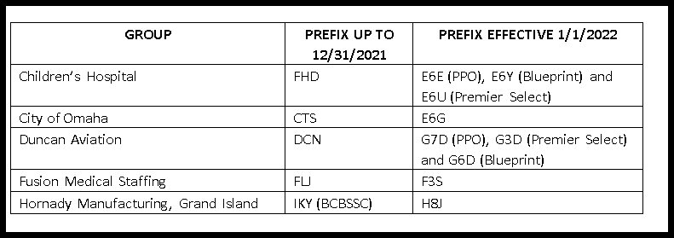
BCBSNE
Highmark
Groups
Notes:
One of the options that BCBSNE and other Blues plans use is the eligibility and benefits and claims platform from a trusted BCBS partner.
To better fit our groups and members needs, from time to time, BCBSNE employer groups will be serviced by a trusted BCBS partner. This is an option that BCBSNE has utilized for several years.
Current transitions to the Highmark platform for Nebraska-based employer groups are above.
Preauthorizations for any of these groups will need to be submitted through Highmark and not BCBSNE. The back of the member’s ID card will also have phone numbers and resources for assistance.

Slide 14
Claims Resolution
Quickly check the status of a claim through NaviNet.
We have made enhancements and continue to evolve in response to your feedback.
If you have already tried NaviNet, you may inquire about a claim through our website and Customer Service will reply via email.
Alternatively, call our Customer Service at 800-635-0579.
If you have attempted to resolve your questions/issues via Customer Service and need further assistance, please contact ProviderExecs@Nebraskablue.com. Please include reference or inquiry numbers with a summary of your concern.
If you have attempted the above and need further assistance, please reach out to your Provider Executive.
14
Notes:
BCBSNE offers several options for claims resolution and status: NaviNet, an online inquiry available at nebraskablue.com; and calling Customer Service.
If you have attempted to resolve your questions or issue from the above options and need further assistance, our Provider Customer Service team at providerexecs@nebraskablue.com is your next resource.
If you have attempted the above options and need further assistance, please reach out to your area’s Provider Executive.
To find your Provider Executive, please see the Provider Contacts page on nebraskablue.com.

Slide 15

Virtual Meetings
On-site office visits are not taking place
Your Provider Executive is available for virtual meetings, via Microsoft Teams
Virtual meetings will occur in the same manner as an in-person visit
Please contact your Provider Executive to schedule a visit
Specific contact information can be found at NebraskaBlue.com/Provider-Contacts
Notes:
Tailored to meet your needs, your Provider Executive is available for virtual meetings, whether it’s a one-time meeting or a recurring meeting.

Slide 16


Questions?
Thank you for your time!

