Slide 1
AAHAM Kearney, NE 2025 Fall

Slide 2
Agenda
Claims and Reimbursement
NaviNet
Medical Management
Medicare Advantage
Communications and Resources
Open Q&A
01
02
03
04
05
06
Notes:
KATRINA – Agenda & housekeeping
15 comm and eng
Claim and-

Slide 3
Notes:
DANA talk about our mission and move into next slide

Slide 4




Redefining Partnership: A Shared Commitment to Better Care
Collaborating with providers, not just contracting with them
Improving processes to reduce administrative burden
Listening and evolving based on your feedback
Focusing on what matters most — better outcomes for patients
Together, we’re not just navigating the system — we’re reimagining it.
Notes:
Throughout our time together you will hear us talk about “partnership” – We have spent the last few years LISTENING to our providers – via surveys, visits across the state from our Provider Advocates and our senior leadership team (Jeff & Gretchen). It was clear that our providers want to work together to make things different to embody one of our own values “Do the right thing for the right reason” and we THANK YOU for that. We took the opportunity to restructure our team and while we continue to have Provider Advocates to support your business office and revenue cycle teams, we saw the need to engage with you strategically – so we can align our strategic initiatives when at all possible and better serve as collaborative partners with our provider community, working together to enhance care delivery, improve patient outcomes, and streamline operations.
Our focus is on building trusted relationships and aligning our strategies with provider goals - ensuring that our efforts support the members and the communities we serve.
We have a strong focus on open dialogue and shared priorities, to ultimately shape a network that’s stronger, more connected, and better equipped to meet evolving healthcare needs. I'll turn it over to Loraine & Jennifer and they will share more on this.

Slide 5
Claims and Reimbursement

Slide 6
Weekly Claim Payment Schedule Change – Effective Nov. 1, 2025
Starting Nov. 1, 2025, each weekly batch claims payment will be comprised only of claims with receipt dates of at least 21 days.
Weekly payment settlement date changes from Thursdays to Mondays.
Change applies to all BCBSNE lines of business, excluding Federal Employee Program (FEP).
Reasons behind change:
• Reduces the need for post-payment corrections
• Allows for sufficient time to review and validate claims
prior to payment.
Supports our ability to continue to provide timely payment in alignment with industry standards.

Slide 7

Weekly Claim Payment Scheduled Change – Effective Nov. 1, 2025
Effective Oct. 1, 2025:
Paper remittance advices will be discontinued
Providers must begin receiving 835s through a
clearinghouse or by accessing remittance advices in
NaviNet®.
Paper checks will no longer be an option after
Oct. 1, 2025.
Forms are available on NaviNet
• Administrative Updates/Secure Forms
Transition to Electronic Remittance Advices
and Payments
Time is running out: Providers who do not complete the transition by the deadline may experience delays in payment and remittance delivery.

Slide 8
Reminders
High dollar claims review – Effective Aug. 1, 2025
Commercial and other lines of business
New threshold: Claims equal to or exceeding $75,000
Medicare Advantage (MA)
New threshold: Claims equal to or exceeding $50,000
Emergency Department claims review – Starting Sept. 1, 2025
Conduent will begin reviewing ED claims to determine the appropriate level of reimbursement based on the diagnosis and services billed
Aligns with industry standards and promotes accurate, fair payment for services rendered
If a claim is selected for review, your office will receive a letter notifying your office of overpaid claim(s) along with a detailed explanation
Review process will follow our standard contractual lookback period of 12 months
Reviews will include all lines of business
Providers will have the option to appeal
Prior Authorization requirements for specialty drugs – Effective Sept. 30, 2025
Providers should begin contacting Prime to obtain prior authorizations for the in-scope drugs for our commercial members with dates of service on or after Sept. 30, 2025.
Physician Office (POS 11)
Patient Home (POS 12)
Outpatient facility (POS 19, 22)

Slide 9
NaviNet
Navinet® is a healthcare provider portal providing services for Blue Cross and Blue Shield of Nebraska.

Slide 10
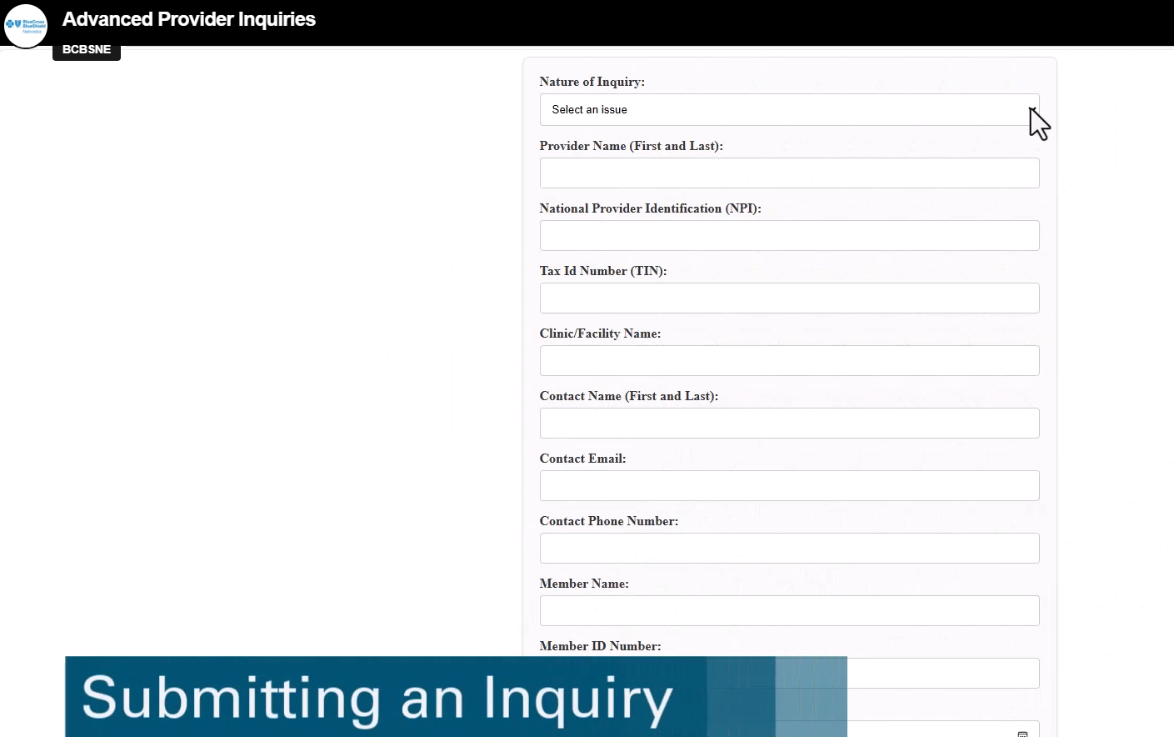
Advanced Provider Inquiry Tool
Enhancing provider communication
This form via NaviNet is designed to streamline the submission process by collecting all necessary information upfront, enabling the appropriate support team to address the inquiry efficiently and reducing the number of communications required.
Notes:
LORAINE
Use link https://navinet.navimedix.com/plan-central/bcbsnebraska#/ for demo
What this really does is take PRESS out of the middle and gets your inquiry to the right team right away. That means the provider support team can focus more on resolving claims escalations—faster and more thoroughly.
With tools like NaviNet self-service, Claims Investigation, CSC, and API in place, our Provider Advocate team has more time to be where they’re most valuable: out in person with YOU.

Slide 11
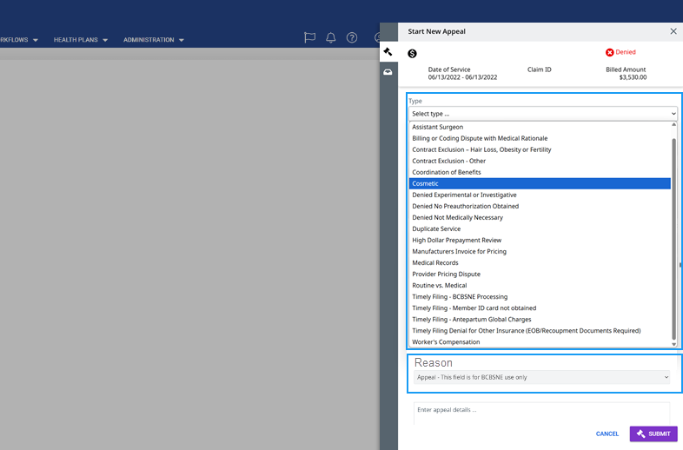
Simplifying NaviNet Claims Appeal/Recon Submissions
What Changed?
New “Type” field will list all available dispute reasons
Once selected, the “Reason” field auto-fills (e.g., appeal, recon, timely filing)
Providers will no longer edit the Reason field manually
Why This Matters?
Ensures clearer intent behind each dispute
Helps route appeals to the right team faster
Reduces errors and improves processing time
Notes:
Can use the Claim appeal/recon in NaviNet elearning. https://www.nebraskablue.com/en/Providers/Provider-Academy/eLearning

Slide 12
Medical Management

Slide 13
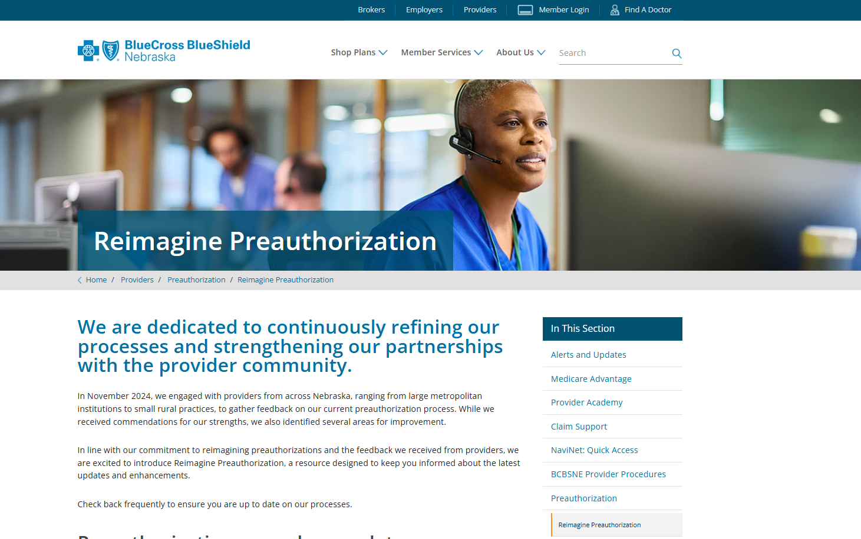
Reimagining Preauthorization
One centralized location
Our new Reimagine Preauthorization page will keep you updated on how we're improving our preauthorization processes. Check back often to stay informed on the changes that matter most to you.

Slide 14
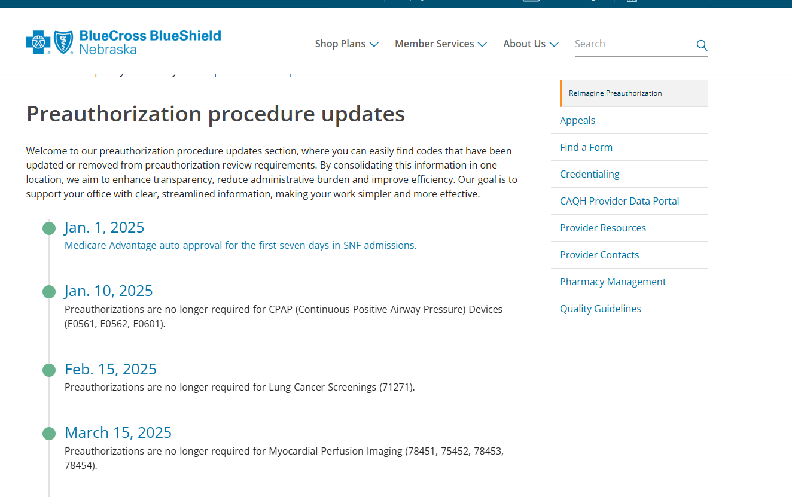
Preauthorization procedure updates
Procedure Updates Made Easy
Quickly find codes added or removed from review
All updates in one place for clarity and efficiency
Designed to reduce admin work and support your office

Slide 15
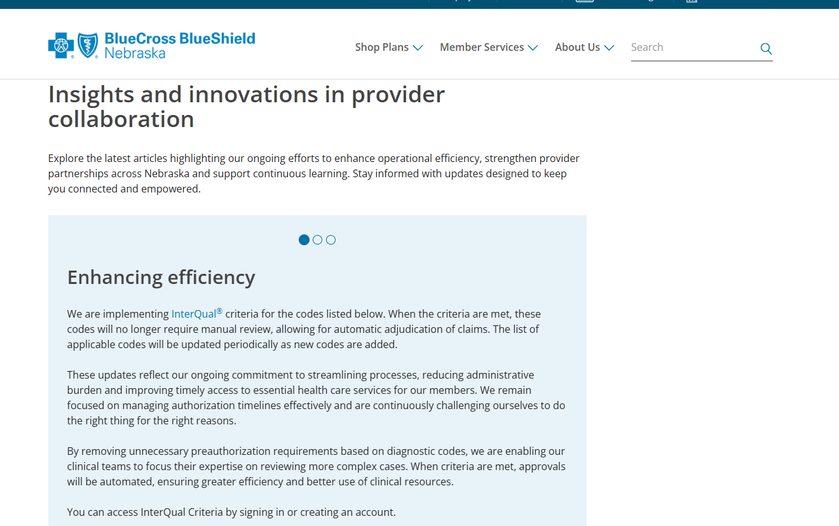
Staying Connected: Insights, Partnerships and Progress
Latest Articles
Enhancing efficiency with InterQual®
InterQual Criteria is evidence-based clinical decision support criteria developed by Change Healthcare, LLC and/or one of its subsidiaries. Change Healthcare, LLC, is an independent company providing services for BCBSNE, an independent licensee of the Blue Cross Blue Shield Association.
Notes:
Effective January 1, 2026, the new law LB77 will be in effect – as I mentioned earlier, BCBSNE worked collaboratively with the NMA, NHA and Senator Elliott Bostar to make the prior authorization process better. We have implemented InterQual criteria for several codes (explain the importance).

Slide 16
Medicare Advantage (MA)

Slide 17

MA Rate Letters and Cost Settlements for Critical Access Hospitals
Access to trainings
You can access this eLearning and the Provider Procedure anytime on NebraskaBlue.com, whenever it’s most convenient for you
Notes:
Link to eLearning eLearning - Provider Academy | BCBSNE this is for Participating MA providers only.

Slide 18


Medicare Advantage Reminders
Timely Filing
Providers are contractually responsible for filing clean claims within the time frame specified in the applicable provider agreement.
Timely Filing Override Requests must be submitted using the Appeal option in NaviNet. Paper submissions will not be reviewed.
Readmissions
Beginning Aug. 1, 2025, BCBSNE MA claims for readmissions will follow the CMS guidelines denying the second admission.
Auto-approvals for SNF admissions
Effective Nov. 1, 2025, auto-approval period adjusted from 7 to 3 days

Slide 19
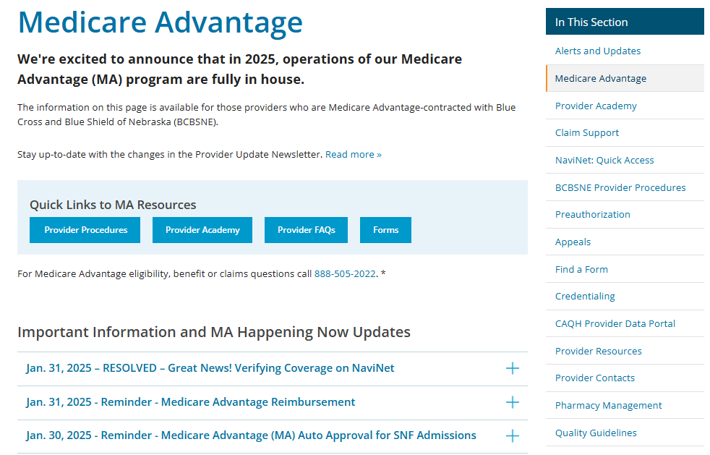
BCBSNE Medicare Advantage Resources
Access a variety of information on the BCBSNE Provider MA site including:
Updates
Communications
Procedure manual
Notes:
Jennifer: remind providers of the auto-approval for seven days in SNF or Swing Bed

Slide 20
Communications and Resources

Slide 21
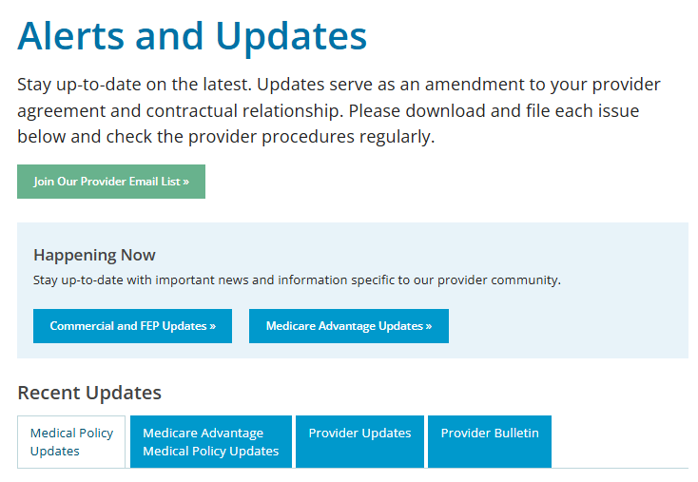
Alerts and Updates Join our Provider Email list (receive an email when a new issue of Provider Bulletin or Provider Update is available) Happening Now (commercial and FEP Updates and Medicare Advantage Updates) Provider Bulletin (monthly) Provider Updates extension of your contract (bi-monthly newsletter)
Alerts & Updates for Providers | BCBSNE
Notes:
We have multiple ways to get the latest news and updates from our team. Make sure you are signed up for our bulletins and newsletters!

Slide 22
Questions
Thank you for your time

