Slide 1
Medical Pharmacy Implementation Prior Authorization Program
Provider Communication and Education
Presented by: Tiffany Morris​, Senior Provider Relations Manager​

Slide 2
Agenda
Program overview
Review process
Provider portal
Resources
01
02
03
04

Slide 3
​Program Overview

Slide 4
Program Overview
Blue Cross and Blue Shield of Nebraska recently communicated a change in the management of certain specialty drugs under the medical benefit for Medicare Advantage (MA) members. This program is expanding to include our Commercial members.
Beginning September 30, 2025, providers should begin contacting Prime Therapeutics to obtain prior authorizations for the in-scope drugs for our Commercial members with dates of service on or after September 30, 2025.
Prime Therapeutics LLC is an independent company providing pharmacy benefit management services for Blue Cross and Blue Shield of Nebraska, an independent licensee of the Blue Cross Blue Shield Association.

Slide 5



Places of Service
Prior authorization is required by Prime when the drugs are administered by practitioners in the following places of service (POS)
Physician
Office
(POS 11)
Patient
Homes
(POS 12)
Outpatient
Facilities
(POS 19, 22)
Inpatient
CAR-T
(POS 21)

Slide 6

Impacted Members
The program applies to Medicare Advantage and Commercial members enrolled in both PPO and HMO plans, with the following exceptions:
Educators Health Alliance (EHA) members are effective Jan. 1, 2026.
  Providers should submit specialty drug prior authorization requests for EHA members through the BCBSNE provider portal.
  EHA member ID numbers begin with the prefix EHN.
Federal Employee Program (FEP) members are not included in this program.
  Please refer to the contact number on the back of the FEP member ID card for assistance.

Slide 7
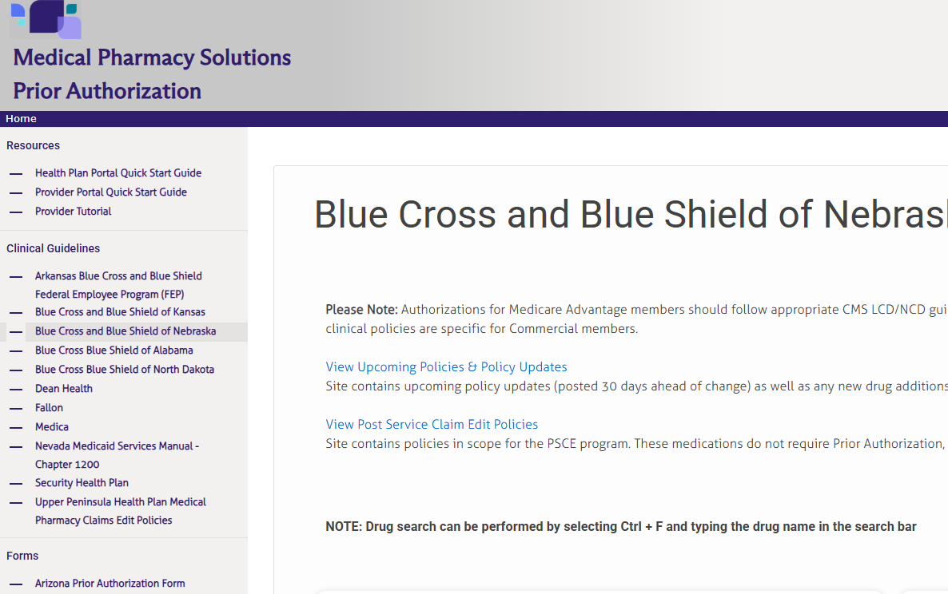
Drugs Requiring Preauthorization through Prime can be located on GatewayPA.com
Please Note:
Authorizations for MA members should follow appropriate CMS LCD/NCD guidelines located on BCBSNE MA Part B Drug Prior Authorization Procedure.

Slide 8
​Review Process

Slide 9


Provider Responsibilities
Ordering Provider
Responsible for obtaining the prior authorization before services are provided
​
Rendering Provider
Responsible for ensuring that the authorization was obtained prior to services being rendered

Slide 10




Information Needed
Provider
Ordering provider name ​
Tax ID​
Practice address​
Office telephone and fax​
(Same information is needed for Rendering Provider if different ​from Ordering Provider)
Member
Member name​
Date of birth​
Member ID number​
Height​
Weight​
Diagnosis code
Medication
Place of service code​
Requested drug name​ or HCPCS code​
Dosage​
Frequency​
Anticipated start date of treatment
Clinical
Clinical notes
Pathology reports
Relevant test results​
If additional information is requested by Prime, the practitioner should be prepared to upload documents on the provider portal or to fax documents to Prime HIPAA compliant fax.

Slide 11

Determination Process Flow
PHYSICIAN REVIEW
The case may be escalated to a Prime physician, who will discuss case with the ordering provider. ​
INTAKE
In most cases, approvals can be made based on initial information provided by the requestor.
PHARMACIST REVIEW
If additional information is needed, the case is routed to a Prime pharmacist who will outreach to the requesting provider.

Slide 12
​Provider Portal

Slide 13
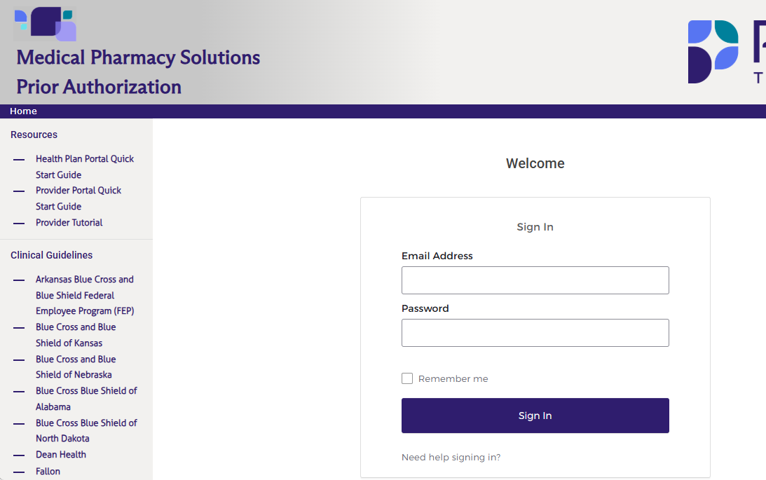
Obtaining an Online Account
GatewayPA.com
Prescribers directly contracted with BCBSNE may create an online account for authorizations in three easy steps:
1. Visit our self-service online portal at GatewayPA.com
2. Click on New Provider Access Request under the Sign In box
3. Complete the form to request access
Please note:
• Authorizations for all Prime Medical Pharmacy Prior Authorizations plans may be managed under one user account. For providers who already have an established account for another health plan, they may email providerinquiry@primetherapeutics.com to request that BCBSNE be added to their account (if applicable).
• The portal is for routine requests only.
• Urgent requests and retroactive requests must be phoned in to the Prime Operations Team at 800-424-1709
• Retroactive requests will only be considered if the claim has not been submitted to BCBSNE.
Providers will have the ability to navigate to NaviNet® to view and request prior authorizations online in the near future. Additional communication will be sent out by BCBSNE regarding this update.

Slide 14
​Resources

Slide 15


Authorization
Resources
For routine requests and clinical guideline information, visit GatewayPA.com or NaviNet*
For urgent or expedited requests call Prime at 1-800-424-1709
Prime has staff available 24 hours a day for urgent requests by phone (including after hours, weekends and holidays). Standard business hours for Prime/MRx are Monday through Friday, 8 a.m. to 6 p.m. EST​
If you have claim, benefits, and/or eligibility questions, please call BCBSNE at 1-888-505-2022 during the hours of operation below
Monday through Friday from 8 a.m. to 7 p.m.
​
*NaviNet® is a healthcare provider portal providing services for Blue Cross and Blue Shield of Nebraska, an independent licensee of the Blue Cross Blue Shield Association.

Slide 16
​
THANK YOU
Tiffany Morris​
Senior Provider Relations Manager​
​
ProviderInquiry@PrimeTherapeutics.com​

