Slide 1
Navigating Medicare 2025
Options & Points to Consider

Slide 2
What is Medicare?
A federal health insurance program for eligible U.S. citizens and legal residents
Funded in part by taxes you pay while working
Individual health insurance

Slide 3
Who is eligible for Medicare?
Must also meet one
of the below criteria
U.S. citizens and legal residents
Legal residents living in the U.S. for at least 5 consecutive years, including the most recent 5 years before applying for Medicare
1
Age 65 or older
Under age 65 with a qualifying disability
Any age diagnosed with End-Stage Renal Disease (ESRD) or ALS
2
3

Slide 4

What if I plan to work past age 65?
Medicare can generally be delayed without penalty if:
Employer has 20+ employees
Employer coverage is considered “creditable”
It may be necessary to enroll at age 65 if:
Employer has <20 employees
Employer coverage is generally NOT considered “creditable”
What if I’m on my spouse’s employer coverage?
It depends on your spouse’s employer and rules the employer has around covered dependents

Slide 5

Enrolling in Medicare while still working
Medicare and employer coverage can work together
  If employer has 20+ employees → Employer coverage is Primary
  If employer has <20 employees → Medicare is Primary
HSA contributions can no longer be made
  HSA funds can still be used for eligible medical expenses
Medicare is individual coverage
  Consider how dependents will be covered

Slide 6


What does Medicare Cover?
Original Medicare has two parts:
Provided & Administered by the federal government
Part A: Hospital Insurance
Helps pay for inpatient hospital services
Part B: Medical Insurance
Helps pay for outpatient and doctor care

Slide 7

Part A: Hospital Insurance
Covered items include but aren’t limited to:
Hospital room and meals
Care in special units, i.e. ICU
Prescriptions and supplies
Surgery and recovery services
Skilled Nursing Facility (SNF) care
Home health care
Hospice

Slide 8
Part B: Medical Insurance
Covered items include but aren’t limited to:
  Doctor visits
  Lab services
  Diagnostic tests, i.e. X-rays, MRIs, etc.
  PT / OT / ST
  Outpatient procedures
  Durable Medical Equipment (DME)

Slide 9




Original Medicare does not cover everything
Non-covered items include:
  All out-of-pocket costs – Beneficiary cost share with no out-of-pocket limit
  Up to 15% excess charges from
  “non-participating” providers
  Prescription
  Drugs
  Routine dental, vision, and hearing care
  Corrective lenses or hearing aids

Slide 10
What does Original Medicare cost?
Medicare Costs
 | 2025
Part A Deductible (per 60 day benefit period) | $1,676
Inpatient days 1 – 60 of each benefit period | $0/day
Inpatient days 61 – 90 of each benefit period | $419/day
Lifetime reserve days (maximum of 60 over lifetime) | $838/day
Skilled Nursing Facility daily coinsurance (days 21 – 100) | $209.50/day
Part B Base Premium (monthly) | $185
Part B Deductible (annual deductible) | $257
Part B Coinsurance (after deductible) | 20%
Part A:
Premium free if you or spouse worked and paid taxes for at least 40 quarters (10 years)
Part B:
Premiums can vary based on income

Slide 11
Part D: Prescription Drug Coverage
Coverage for prescription drugs and some vaccines
  Premiums vary by plan
  Cost sharing → Deductible / Copays / Coinsurance
  Determined by drug tier
  Late Enrollment Penalty (LEP) possibility
  If not enrolled while eligible for 63 continuous days or more

Slide 12



Part D: 2025 prescription drug coverage
  Coverage stages are standardized
2025 coverage stages
Annual
deductible
Up to plan
deductible
Initial
coverage
Catastrophic coverage
Up to $2,000
True-Out-of-Pocket
(TrOOP)
Agent use only. Not to be shared or distributed without consent from BCBSNE.

Slide 13


Where can I get more coverage?
Option 1
Add one or both of the
following to Original Medicare:
OR
Option 2
Choose a
Medicare Advantage plan:
Medicare Supplement Insurance (Medigap)
Offered by private insurance companies
Medicare Advantage (Part C) Plan
Offered by private insurance companies
Helps pay some or all of the out-of-pocket costs not paid by Original Medicare
Part C
Combines Part A (hospital insurance) and
Part B (medical insurance) in one plan
Medicare Part D Plan
Offered by private insurance companies
Part D
Usually includes prescription drug coverage
May offer additional benefits like vision
and dental coverage
Helps pay for prescription drugs

Slide 14
Medicare Supplement
Highlights
Plans help pay out-of-pocket costs not paid by Original Medicare
Offered by private insurance companies
Plans labeled by letters and are standardized by Federal and State law
Same letter plans offer the same benefits except in MA, MN, and WI which standardize differently
Plans do not help cover:
  Prescription drugs
  Routine dental, vision, or hearing care
  Corrective lenses or hearing aids
  Long-term care

Slide 15
Medicare Supplement
Eligibility & Use
Must be enrolled in Medicare Part A & Part B
Part B premium must continue to be paid
Must reside in the state where the plan is offered
Not subject to medical underwriting when in Open Enrollment period (Up to 6 months from T65 or enrolling in Part B)
Underwriting to determine rate and/or acceptance when not in Guarantee Issue scenario
Guaranteed renewable with premium payments
Premiums vary based on plan and insurance carrier
More coverage = generally higher monthly premium
Monthly premiums can change every year
No provider network (except with Medicare Select plans)

Slide 16

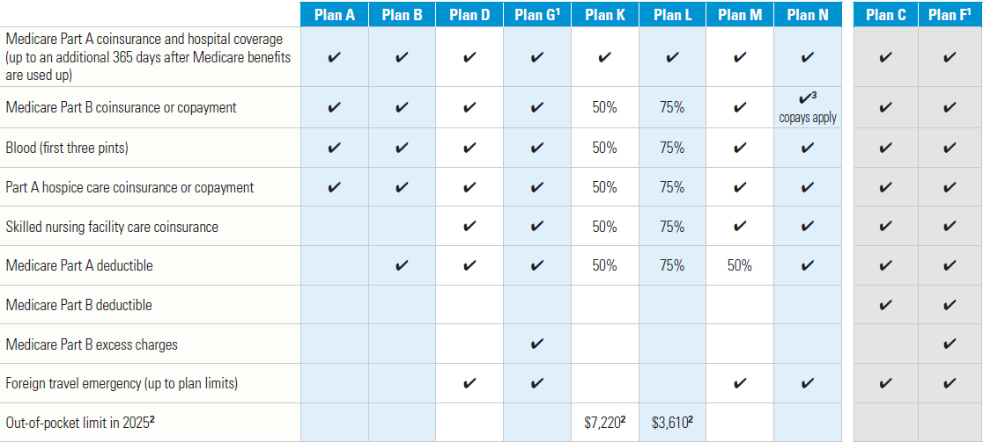
Medicare Supplement

Slide 17
Part C: Medicare Advantage
Highlights
Alternative to Original Medicare
Members still have Medicare and must maintain Medicare eligibility/enrollment
Plans and benefits are offered and administered by private insurance companies
Medicare Advantage plans cover:
  All Part A benefits (Hospice is still covered by Part A)
  All Part B benefits
  Part D prescription drugs (unless MA only)
Medicare Advantage plans may include benefits such as:
  Routine dental, vision, and hearing care
  Corrective lenses and hearing aids
  Fitness memberships and Over-the-Counter allowances

Slide 18
Part C: Medicare Advantage
Eligibility & Use
Must be enrolled in Medicare Part A & Part B
Part B premium must continue to be paid
Must reside in the plan service area
Not subject to medical underwriting
No exclusions for pre-existing conditions
Benefits vary by plan and can change every year
Plans may charge a monthly premium
Provider networks could be required based on plan type (HMO, PPO)
Cap on annual out-of-pocket costs for covered care
Cost share (copay/coinsurance) when care is utilized

Slide 19
How to Choose
Points to Consider

Slide 20
Coverage Choices
1
Enroll in
Original Medicare
2
Decide if additional coverage is needed
Option 1
Add one or both of the
following to Original Medicare:
OR
Option 2
Choose a
Medicare Advantage plan:
Original Medicare
Provided & administered by the federal government
Medicare Supplement Insurance (Medigap)
Offered by private insurance companies
Medicare Advantage (Part C) Plan
Offered by private insurance companies
Helps pay some or all of the out-of-pocket costs not paid by Original Medicare
Part C
Combines Part A (hospital insurance) and
Part B (medical insurance) in one plan
Part A
Hospital & Inpatient care
Medicare Part D Plan
Offered by private insurance companies
Part D
Usually includes prescription drug coverage
Part B
Doctor visits & Outpatient care
May offer additional benefits like vision
and dental coverage
Helps pay for prescription drugs

Slide 21
Things to consider:
Medicare Supplement | Medicare Advantage
Monthly premium Part D premium Other stand-alone coverage premiums Out-of-pocket costs determined by choice of plan (i.e. Plan G) | Monthly premium (if applicable) Part D included in plan premium (if MAPD) Cost share for covered services Annual Maximum out-of-pocket protection
Cost

Slide 22
Things to consider:
Medicare Supplement | Medicare Advantage
Pays some costs not covered by original Medicare Nationwide coverage No prescription coverage | Original Medicare benefits If MAPD, prescription drug coverage included Networks of providers Additional benefits beyond original Medicare (dental, vision, hearing, etc.)
Coverage

Slide 23
Questions
Thank you for your time

Slide 24




Over 65 Sales
Adam welch
Manager, Individual Sales
Over 65
p: (402) 319-6642
e: Adam.Welch@NebraskaBlue.com
Jenny Robinson
Individual Account Executive
Over 65
p: (402) 982-7896
e: Jenny.Robinson@NebraskaBlue.com

